Slide 1
Big Data on AWS
Insert Trainer name Here

Slide 2
Agenda
Module 0: AWS Technical Essentials
Module 1: Big Data Pipelines on AWS
Module 2: Ingestion/Transfer data to AWS
Module 3: Streaming with Kinesis
Module 4: AWS Storage options
Module 5: AWS S3
Module 6: Amazon DynamoDB
Module 7: Athena
Module 8: AWS EMR
Module 9: Glue
Module 10: Redshift
Module 11: Data pipeline
Module 12: AWS Lambda

Slide 3
Module 0
AWS technical essentials

Slide 4
Module 1
Big data overview and pipeline

Slide 5
Agenda
What is Big Data?
Use Cases/Applications
Big Data Pipeline
Big Data ecosystem frameworks and tools
Notes:
https://aws.amazon.com/blogs/big-data/how-coursera-manages-large-scale-etl-using-aws-data-pipeline-and-dataduct/

Slide 6
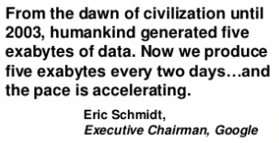

Slide 7
What is Big Data?
3 V’s
Velocity
Volume
Variety
Big Data is one of the things that have implications for everyone and is completely transforming the way we do business and impacting most other parts of our lives.

Slide 8
Data Sources
Activity Data
Conversation Data
Photo and Video Image data
Sensor Data
IOT Data
The Latest technology such as Cloud Computing and distributed systems together can be used to allow us to leverage all types of data to gain insights and add value.

Slide 9
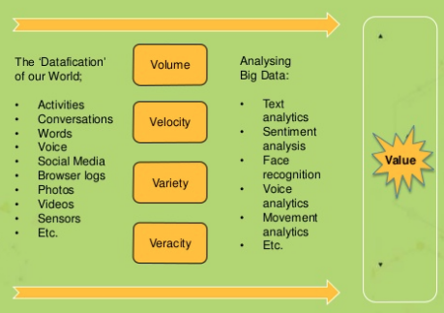
Turning Big Data into Value

Slide 10
Use Cases
Better understand and target customers
Understand and Optimize business processes
Improving Health
Improving security and law enforcements
Improving sports performance
Improving and optimizing cities and countries
But the applications are endless!!

Slide 11
Big Data Evolution
Batch Processing
to
Stream Processing
to
Artificial Intelligence

Slide 12
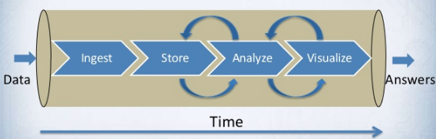
Big Data Pipeline

Slide 13
What Kinds of Tools Can I Use With AWS?
Collect
Store
Process and Analyze
Visualize
Notes:
As displayed above, AWS big data solutions are compatible with an enormous collection of non-AWS tools at every stage of the pipeline. These are just a small collection of the tools available for use within the AWS big data ecosystem.

Slide 14
Where Do AWS Solutions Map to the Pipeline?
Store
Process and Analyze
Visualize
Collect
Notes:
On AWS, collection and ingestion can be accomplished by using Amazon EC2 instances that run Amazon Kinesis-enabled applications or other applications designed for ingestion. AWS Data Pipeline can also be used to ingest data from on-premises sources into AWS.
We have a wide variety of storage solutions; however, the most commonly used solution in big data environments running on AWS is Amazon S3. We discuss these storage solutions later in the course.
Note Because of the nature of big data, storage is used both before and after the analysis and processing phases—for storing results before viewing and for further analysis or processing.
The primary tool for big data processing in the AWS big data ecosystem is Amazon EMR, which is discussed in the next several modules. Amazon Redshift, a petabyte-scale data warehouse solution, is discussed on day three of the course and is the primary solution for finding more detailed answers from analyses of your data. This course also covers Amazon Kinesis, our streaming data processing solution, and AWS Data Pipeline, our data transformation solution, in later modules.

Slide 15
Big Data Architectural Principals
Build Decoupled Systems
Using the right tool for the job
Latency
Access Patterns
Throughput
Data Structure
Leverage Managed/Serverless Services
Use log centric design patterns
Be cost aware
AI/ML enable your app

Slide 16
Quiz

Slide 17
Module 2
Data collection

Slide 18
Agenda
Data Collection in Big Data
Data Transfer to AWS
Notes:
https://aws.amazon.com/blogs/big-data/how-coursera-manages-large-scale-etl-using-aws-data-pipeline-and-dataduct/

Slide 19
Data Collection
Collecting data from “multiple sources” and converting into a “sequential Stream” to store durably so that it is easier to process later.

Slide 20
Data Collection: Types
Transactional Data → ?
Files Data → ?
Stream Data → ?

Slide 21
Data Collection Tools
Flume
Scoop
DMS
Kafka
Kinesis
Kinesis Agent

Slide 22
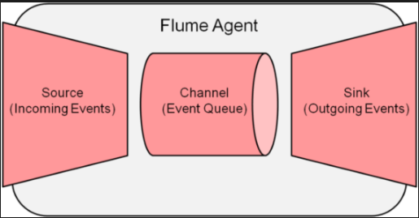
Flume

Slide 23
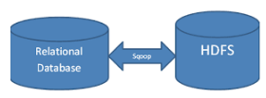
Scoop

Slide 24
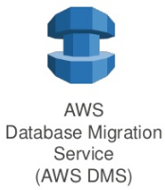
DMS (Database Migration Service)

Slide 25
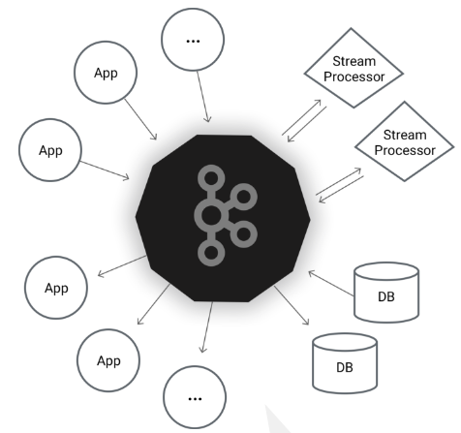
Kafka
Pub-Sub
Process
Store

Slide 26
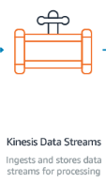
Kinesis
Easily Collect, Process and analyze data streams in real-time.

Slide 27
Kinesis Agent
Offers an easier way to collect and ingest data into Amazon Kinesis services
Features:
Monitors file patterns and sends new data records to delivery streams
Handles file rotation, checkpointing, and retry upon failure
Delivers all data in a reliable, timely, and simpler manner
Emits Amazon CloudWatch metrics

Slide 28
Transferring Data to AWS
S3DistCp
VPN
Direct Connect
S3 Multipart Upload
AWS Snowball
AWS Snowball Edge
AWS Snowmobile

Slide 29
S3DistCp
Extension of DistCp
To work with S3
Can be used as a step or at command line to move data between
S3 – HDFS
HDFS – S3
S3 – S3

Slide 30
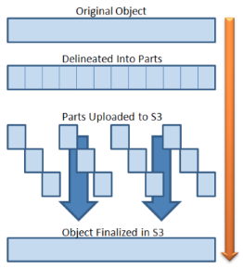
S3 Multipart Upload

Slide 31
AWS Snowball
Benefits
High Speed
Terabytes scale
Tamper resistant and secure
Simple and Compatible
Low cost
Easy data retrieval
Uses
Cloud Migrations
Disaster recovery
Datacenter decommissioning
Content Distribution

Slide 32
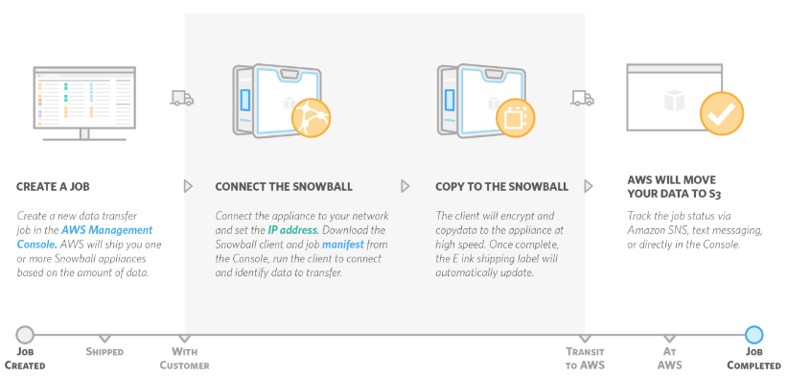
How Snowball works?

Slide 33
AWS Snowball Edge
100 TB capacity with Storage and compute capability
Compute = m4.4xlarge
Lambda Functions
Cluster capabilities
Uses:
Medical
Research Ships
IOT
Manufacturing

Slide 34

AWS Snowmobile

Slide 35
Module 3
AWS Kinesis Streams

Slide 36
What Can I do with Streams?
Use Cases
Accelerated log and data feed intake and processing
Real-time metrics and reporting
Real-time data analytics
Complex stream processing

Slide 37
Benefits of using Streams
Low latency
Multiple clients can consume at the same time
Managed
Fault-tolerant consumption using KCL

Slide 38
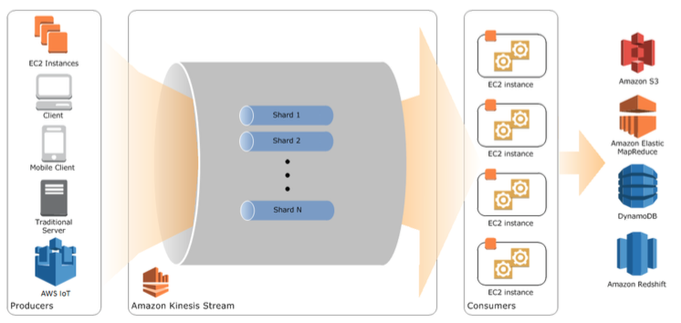
Amazon Kinesis Streams- High Level Architecture

Slide 39
Stream Terminology
Stream
Data Records
Retention Period
Producers
Consumers
Shards
Partition Keys
Sequence Numbers
KPL/KCL
Application Name

Slide 40
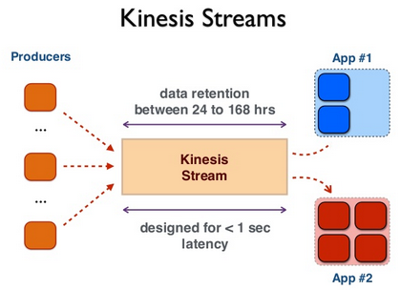

Slide 41
Kinesis Data Record
Partition key
Sequence Number
Blob

Slide 42
Putting Data Into Amazon Kinesis Streams
Each shard in a stream:
Ingests up to 1 MB/sec of data, up to 1000 transactions per second (TPS).
Emits up to 2 MB/sec of data.
Streams can be scaled by adding and removing shards.
Streams use a simple PUT interface to store data.
Producers use PUT calls to store data in a stream.
Partition keys are used to distribute PUTs across shards.
A unique sequence number is returned to the producer on successful PUT.

Slide 43
How Data Moves Through Amazon Kinesis Streams
EC2 Instance A
Count of Red: 4
Key = Red
Kinesis Stream
Producer A
4 | 3 | 2 | 1
Shard A
Count of Blue: 4
Key = Green
4 | 4 | 3 | 3 | 2 | 2 | 1 | 1
Producer B
4 | 3 | 2 | 1
Key = Blue
Shard B
Producer C
4 | 3 | 2 | 1
4 | 4 | 3 | 3 | 2 | 2 | 1 | 1
EC2 Instance B
Key = Purple
Count of Purple: 4
Producer D
4 | 3 | 2 | 1
Count of Green: 4

Slide 44
Initial Size of Kinesis Stream
number_of_shards =
max(incoming_write_bandwidth_in_KB/1000, outgoing_read_bandwidth_in_KB/2000)

Slide 45
Streams Data Visualization Sample App
Note: incurs nominal charges.
Step 1: Start the Sample App
Step 2: View Components of the Sample App
Step 3: Delete Sample Application
Note: https://github.com/awslabs/amazon-kinesis-data-visualization-sample

Slide 46
Step 1: Start the Sample App
Let’s discuss the template.
https://s3.amazonaws.com/kinesis-demo-bucket/amazon-kinesis-data-visualization-sample/kinesis-data-vis-sample-app.template

Slide 47
Step 2: View Components of the Sample App
Producer
HttpReferrerKinesisPutter
HttpReferrerStreamWriter
Consumer
HttpReferrerCounterApplication
HttpReferrerCounterApplication
CountingRecordProcessor
Let’s discuss these classes from the github repo.

Slide 48
Step 3: Delete Sample Application

Slide 49
Producer
Kinesis Stream API
Kinesis Producer Library

Slide 50
Role of the KPL
Automatic and configurable retry mechanism
Collects records and uses PutRecords to write multiple records
Aggregates user records to increase payload size and improve throughput
Integrates with KCL seamlessly
Submits Cloudwatch metrics

Slide 51
Advantages of Using KPL
Performance Benefits
Consumer-side Ease of Use
Producer Monitoring
Asynchronous Architecture

Slide 52
When Not To Use the KPL?
Consider RecordMaxBufferedTime

Slide 53
Consumer
Kinesis Stream API
KCL (Kinesis Client Library)

Slide 54
Role of the KCL
The KCL performs the following tasks:
Connects to the stream
Enumerates the shards
Coordinates shard associations with other workers (if any)
Instantiates a record processor for every shard it manages
Pulls data records from the stream
Pushes the records to the corresponding record processor
Checkpoints processed records
Balances shard-worker associations when the worker instance count changes
Balances shard-worker associations when shards are split or merged

Slide 55
Developing Amazon KCL Consumer
Implement the IRecordProcessor Methods
Implement a Class Factory for the IRecordProcessor Interface
Create a Worker
Modify the Configuration Properties

Slide 56
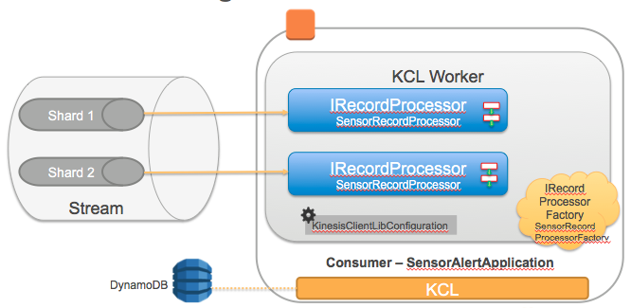
KCL

Slide 57
Handling ProvisionedThroughputExceededException
Retry
Reshard
Log and Monitor
DynamoDB table throughput

Slide 58
KCL: Recovery from Failure
Record processor failure
The worker automatically restarts the record processor.
Worker failure
Catch exceptions thrown by worker and handle appropriately.
Application failure
Restart application to restart worker and record processors.
EC2 instance failure
Run the application in an Auto Scaling group. Configure EC2 instance to start your application at startup.

Slide 59
Building Amazon Kinesis Streams Applications
Kinesis Client Library (KCL) enables distributed processing:
Automatically starts a worker for each shard.
Simplifies reading stream by abstracting shards.
Adds or subtracts workers as number of shards changes.
Checkpoints keep track of worker’s location in the stream.
Restarts workers if they fail.
EC2 instance (Worker 1)
Amazon Kinesis Stream
Record Processor 1
Shard 1
Record Processor 2
Shard 2
EC2 instance (Worker 2)
Shard 3
Record Processor 1
Shard 4
Record Processor 2
Shard 100
EC2 instance (Worker M)
Record Processor 1
Shard N
Record Processor Y
Notes:
An Amazon Kinesis streaming application should have the following attributes:
Distributed to handle multiple shards
Fault-tolerant to handle failures in hardware or software
Elastic to scale up and down as the number of shards increases or decreases
The Amazon Kinesis Client Library enables developers to build streaming data processing applications. Leveraging the client library, developers can focus on business logic and let the client library automatically handle complex issues, such as adapting to changes in stream volume, load-balancing streaming data, coordinating distributed services, and processing data with fault tolerance.
The Amazon Kinesis Client Library simplifies parallel processing of streaming big data by allowing customers to write simple applications for processing records. The client library is a Java library that customers compile into their data processing application. An application that contains the client library is called a worker. The library notifies the processing code when there is new data to process. Workers often process data and write output to an external data store such as DynamoDB, Amazon EMR, Amazon Redshift, or Amazon S3. Every record within an Amazon Kinesis data stream is processed at least once.

Slide 60
Building Amazon Kinesis Streams Applications
Use KCL with Auto Scaling groups:
Auto Scaling policies restart instances if they fail.
Automatically adds instances when load increases.
Redistributes workers to use new instances.
Use the GET APIs for raw reads of data streams.
EC2 instance (Worker 1)
Amazon Kinesis Stream
Record Processor 1
Shard 1
Record Processor 2
Shard 2
EC2 instance (Worker 2)
Shard 3
Record Processor 1
Shard 4
Record Processor 2
Shard 100
EC2 instance (Worker M)
Record Processor 1
Shard N
Record Processor Y
Notes:
For more information about the Amazon Kinesis Client Library, see https://github.com/awslabs/amazon-kinesis-client.

Slide 61




Amazon Kinesis Connector Library
AWS
Lambda
Amazon S3
ITransformer
IFilter
IBuffer
IEmitter
Defines the transformation of records from the Amazon Kinesis stream in order to suit the user-defined data model
Excludes irrelevant records from the processing
Buffers the set of records to be processed by specifying size limit (# of records) and total byte count
Makes client calls to other AWS services and persists the records stored in the buffer
Amazon DynamoDB
Amazon Kinesis
Amazon Redshift
Customizable, open source applications connect Amazon Kinesis Streams with Amazon S3, Amazon Redshift, Amazon DynamoDB, Amazon EMR, and AWS Lambda.
Amazon EMR
Notes:
The Amazon Kinesis Connector Library helps Java developers integrate Amazon Kinesis Streams with other AWS services. The current version of the library provides connectors for Amazon DynamoDB, Amazon Redshift, and Amazon S3. The library also includes sample connectors of each type, plus Apache Ant build files for running the samples.
Each Amazon Kinesis connector application is a pipeline that determines how records from an Amazon Kinesis stream are handled. Records are retrieved from the stream, transformed according to a user-defined data model, buffered for batch processing, and then emitted to the appropriate AWS service.
A connector pipeline uses the following interfaces:
IKinesisConnectorPipeline: The pipeline implementation itself.
ITransformer: Defines the transformation of records from the Amazon Kinesis stream in order to suit the user-defined data model. Includes methods for custom serializer/deserializers.
IFilter and IBuffer: IFilter defines a method for excluding irrelevant records from the processing. IBuffer defines a system for buffering the set of records to be processed; it specifies the size limit (number of records) and total byte count.
IEmitter: Defines a method that makes client calls to other AWS services and persists the records stored in the buffer. The records can also be sent to another Amazon Kinesis stream.
Each connector depends on the implementation of KinesisConnectorRecordProcessor to manage the pipeline. The KinesisConnectorRecordProcessor class implements the IRecordProcessor interface in the Amazon Kinesis Client Library.
For more information about the Amazon Kinesis Connector Library, see https://github.com/awslabs/amazon-kinesis-connectors.

Slide 62
Learning Amazon Kinesis Streams Development

Slide 63
Step 0: Connect to the Development Box

Slide 64
Step 1: Create a Stream
Factors to consider for choosing number of shards
Average Record Size
Maximum records written/second
Number of consumer applications

Slide 65
Step 2: Create IAM policy and user

Slide 66
Troubleshooting KCL Consumers
Some Streams Records are Skipped When Using the Kinesis Client Library
Consumer Application is Reading at a Slower Rate Than Expected
Records Belonging to the Same Shard are Processed by Different Record Processors at the Same Time
GetRecords Returns Empty Records Array Even When There is Data in the Stream
Shard Iterator Expires Unexpectedly
Consumer Record Processing Falling Behind

Slide 67
Kinesis Services
Use Kinesis Data Firehose to load data streams into AWS data stores.
Use Kinesis Data Streams to build custom applications that analyze data streams using popular stream processing frameworks.
Use Kinesis Data Analytics to analyze data streams with SQL.
Use Kinesis Video Streams to capture, process, and store video streams for analytics and machine learning.

Slide 68
Kinesis Data Firehose
Is the easiest way to load, transform, batch and compress streaming data into systems like S3, ElasticSearch or Redshift.
Fully Managed.
No shards.
Auto scales.

Slide 69
Kinesis Analytics
Process steaming data in near real time.
Fully Managed
Pay per use.
SQL interface
Pre-built functions…

Slide 70
Demo/Lab: Kinesis Data Analytics

Slide 71
Module 4
Data Storage

Slide 72
Agenda
Explore Data Storage Options in AWS
What is a Data Lake?
AWS Service for Data Lake
Considerations while choosing data storage option
Notes:
https://aws.amazon.com/blogs/big-data/how-coursera-manages-large-scale-etl-using-aws-data-pipeline-and-dataduct/

Slide 73
AWS Data Storage Options
Instance Store
EBS
EFS
S3
Glacier
RDS
DynamoDB
ElastiCache
Redshift
ElasticSearch
HDFS with EMR

Slide 74
Big Data Design Principal
Choose the right tool for the Job!

Slide 75
Data Lake?
A data lake is a storage repository that holds a vast amount of raw data in its native format until it is needed.
Benefits:
Single source of truth
Fast ingestion (Schema on read)
Decoupled Storage and compute

Slide 76
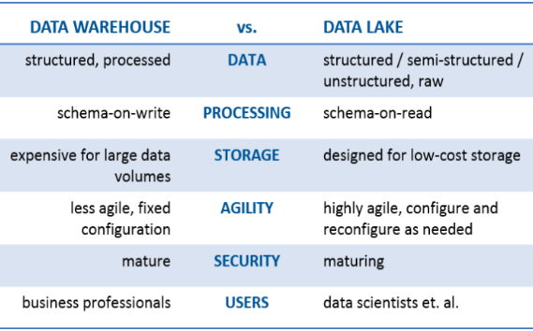

Slide 77
S3 as Data Lake?
S3 is integrated with most AWS services and central to AWS philosophy of data lake.
Durable
Highly Available
Scalable
High Performance
Easy to Use
Support unstructured data as objects
Integration with EMR
Parallel consumption
Supports Data partitioning

Slide 78
Considerations in choosing data store?
1. Hot? Worm? Cold?
2. Access Patterns
3. Data Structure
4. Cost
5. Concurrent Queries

Slide 79
Access Patterns
Access Pattern What to Use?
Faceting, Searching ?
Get/Put(K-V) ?
Simple relationships 1:1 1:M ?
Complex joins, transactional ?
OLAP/DWH ?

Slide 80
Data Structure
Data Structure What to Use?
Fixed Schema ?
Key-Value ?
Unstructured(JSON) ?

Slide 81
Data Store Comparison
Factors
Volume
Latency
Item Size
Request Rate
Cost per GB
Durability

Slide 82
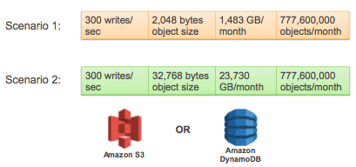
Cost

Slide 83
AWS Simple Monthly Calculator

Slide 84
Case Study

Slide 85
Quiz

Slide 86
Module 5
Amazon s3

Slide 87
Amazon S3: Benefits
Object storage built to store and retrieve any amount of data from anywhere
Unmatched durability, availability, & scalability
Designed to deliver 99.999999999% durability and 99.99% high availability
Store unlimited data
Most comprehensive security & compliance capabilities
Supports three different forms of encryption
Supports security standards and compliance certifications including PCI-DSS, HIPAA/HITECH, FedRAMP, EU Data Protection Directive, and FISMA
Query in place
Allows you to run sophisticated big data analytics on your data

Slide 88
Amazon S3: Benefits
Offers the most flexible set of storage management and administration capabilities.
Analyze object access patterns to build lifecycle policies that automate tiering, deletion, and retention
Includes tens of thousands of consulting, systems integrator and independent software vendor partners for solutions like Backup & Recovery, Archiving, and Disaster Recovery.

Slide 89
Amazon S3: Use cases
Backup & recovery
Static website hosting
Data archiving
Data lakes & big data analytics
Hybrid cloud storage
Cloud-native application data
Disaster recovery

Slide 90
Instance Store vs EBS vs S3 vs EFS
Instance Store | Amazon EBS | Amazon S3 | Elastic File System
Block level storage | Block level storage | Object storage service | File storage service
Located on disks that are physically attached to the host computer | Deliver performance for workloads that require the lowest-latency access to data from a single EC2 instance. | Makes data available through an Internet API that can be accessed anywhere. | Provides a file system interface, file system access semantics, and concurrently-accessible storage for up to thousands of Amazon EC2 instances
Ideal for temporary storage of information that changes frequently, such as buffers, caches, scratch data, and other temporary content | Ideal for Big Data analytics engines, relational and NoSQL databases, and stream and log processing applications | Ideal for backing up and archiving, can be used as data lake for big data analytics | Ideal for Enterprise Applications and Applications Delivered as a Service and Content Management and Web Serving

Slide 91
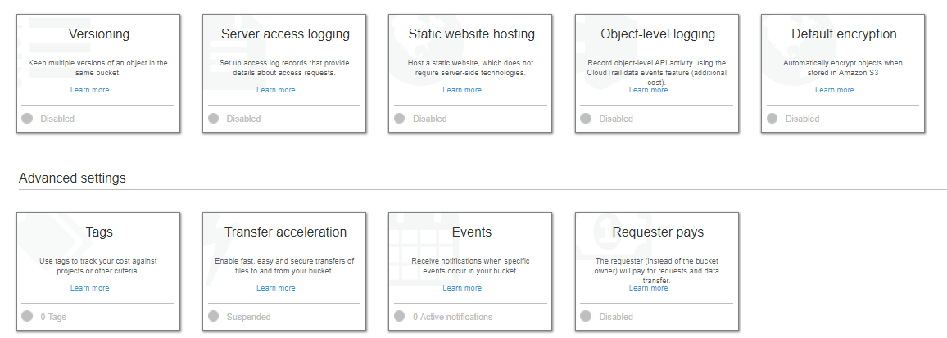
Amazon S3: Bucket Properties

Slide 92
Amazon S3: Bucket Properties
Versioning enables you to keep multiple versions of an object in one bucket.
By default, versioning is disabled for a new bucket.

Slide 93
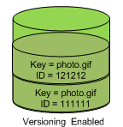
Amazon S3: Versioning
Versioning is a means of keeping multiple variants of an object in the same bucket.
Versioning enables you to:
Preserve, retrieve, and restore every version of every object
Recover from both unintended user actions and application failures
Recover objects from accidental deletion or overwrite
In one bucket, for example, you can have two objects with the same key, but different version IDs, such as photo.gif (version 111111) and photo.gif (version 121212).

Slide 94
Amazon S3: Bucket Properties
Server access logging provides detailed records for the requests that are made to your bucket.
By default, Amazon S3 does not collect server access logs.

Slide 95
Amazon S3: Bucket Properties
You can host a static website on Amazon S3. To enable static website hosting, choose
Static website hosting and then specify the settings you want to use.

Slide 96
Amazon S3: Bucket Properties
Object-level logging records object-level API activity by using CloudTrail data events.

Slide 97
Amazon S3: Bucket Properties
You can set default encryption on a bucket so that all objects are encrypted when they are stored in the bucket.
The objects are encrypted using server-side encryption with either Amazon S3-managed keys (SSE-S3) or AWS KMS-managed keys (SSE-KMS).

Slide 98
Amazon S3: Bucket Properties
With AWS cost allocation, you can use bucket tags to annotate billing for your use of a bucket.
A tag is a key-value pair that represents a label that you assign to a bucket.

Slide 99
Amazon S3: Bucket Properties
Amazon S3 Transfer Acceleration enables fast, easy, and secure transfers of files over long distances between your client and an S3 bucket.

Slide 100
Amazon S3: Bucket Properties
You can enable certain Amazon S3 bucket events to send a notification message to a destination whenever the events occur.
To enable events, choose Events and then specify the settings you want to use.

Slide 101
Amazon S3: Bucket Properties
You can enable Requester Pays so that the requester (instead of the bucket owner) pays for requests and data transfers.

Slide 102
Control Bucket Access
IAM Policy
Bucket Policy
ACL

Slide 103
S3 Demo
Create a bucket
Upload object to the bucket using Console
Control Access using Bucket Policy
List bucket objects using CLI

Slide 104
Amazon S3: Pricing
With S3, pay only for what you use.
Pay | Do Not Pay
GBs per month | Transfer IN to Amazon S3
Transfer OUT to other regions | Transfer OUT from Amazon S3 to Amazon CloudFront or Amazon EC2 in the same region.
PUT, COPY, POST, LIST, and GET requests

Slide 105
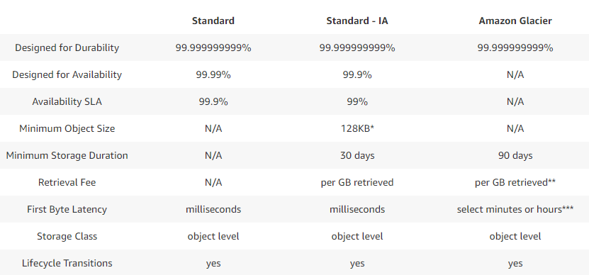
Amazon S3: Storage Classes

Slide 106
Amazon S3: Storage Classes
Metrics | Standard (HOT) | Standard-IA (COLD) | Glacier (COLDER)
Storage
GET/PUT etc.
Data Out
Latency | Immediately | Immediately | Default (3-5 hours)

Slide 107
Reduced Redundancy Storage
RRS can be used to reduce the cost of data storage for data that we may be able to re-compute in case of object lost.
S3 reduces the numbers of replica

Slide 108
Amazon S3: Lifecycle Management
Amazon S3 Standard
Amazon S3
Standard – Infrequent Access
Amazon Glacier
30 days
60 days
Video.mp4
Video.mp4
Video.mp4
You can set lifecycle rules per object or per bucket.
Transition actions – In which you define when objects transition to another storage class.
Expiration actions – In which you specify when the objects expire. Then Amazon S3 deletes the expired objects on your behalf.

Slide 109
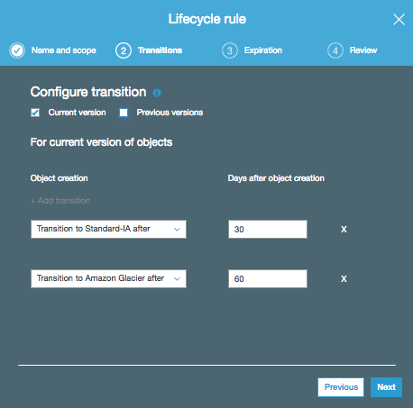
S3 Lifecycle Management

Slide 110
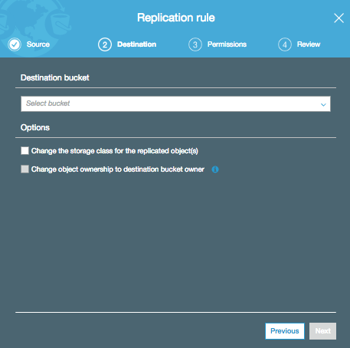
S3 Cross Region Replication
Can be used in case of Disaster Recovery or Latency etc use cases.

Slide 111
Amazon S3: Cross-Region Replication
Cross-region replication is a bucket-level configuration that enables automatic, asynchronous copying of objects across buckets in different AWS Regions.
Replication Configuration: Basic
Buckets can be owned by different AWS accounts
Add a replication configuration to your source bucket
Add destination bucket where you want Amazon S3 to replicate the objects
Add details about the objects you want to replicate
Specify a storage class to use for object replicas in the destination bucket
By default, Amazon S3 uses the storage class of the source object to create an object replica

Slide 112
Amazon S3: Cross-Region Replication
Additional Configuration:
Replicating objects created with server-side encryption (SSE) using AWS kms-managed encryption keys
Change replica owner

Slide 113
S3 Demo for Lifecycle Policy and CRR

Slide 114
Amazon S3: Consistency
Read-after-write consistency for PUTS of new objects in your S3 bucket
Eventual consistency for overwrite PUTS and DELETES in all regions
Updates to a single key are atomic
Example: If you PUT to an existing key, a subsequent read might return the old data or the updated data, but it will never write corrupted or partial data.
Amazon S3 does not currently support object locking

Slide 115
Amazon S3: Consistency
Amazon S3 achieves high availability by replicating data across multiple servers within Amazon's data centers.
If a PUT request is successful, your data is safely stored. However, information about the changes must replicate across Amazon S3, which can take some time, and so you might observe the following behaviors:
Action | S3 Behavior
Write a new object to Amazon S3 and immediately list keys within the bucket | Until the change is fully propagated, the object might not appear in the list
Replace an existing object and immediately attempt to read it | Until the change is fully propagated, Amazon S3 might return the prior data
Delete an existing object and immediately attempt to read it | Until the deletion is fully propagated, Amazon S3 might return the deleted data
Delete an existing object and immediately list keys within its bucket | Until the deletion is fully propagated, Amazon S3 might list the deleted object.

Slide 116
Amazon S3: Protecting Data
Data protection refers to protecting data while in-transit (as it travels to and from Amazon S3) and at rest (while it is stored on disks in Amazon S3 data centers).
Data in Transit: SSL or client side encryption
Data at Rest
Use Server-Side Encryption
Use Client-Side Encryption

Slide 117
Amazon S3: Protecting Data Using SSE
You have three mutually exclusive options depending on how you choose to manage the encryption keys:
Server-Side Encryption with Amazon S3-Managed Keys (SSE-S3)
Server-Side Encryption with AWS KMS-Managed Keys (SSE-KMS)
Server-Side Encryption with Customer-Provided Keys (SSE-C)
Encrypted with a unique key
Unique key is further encrypted with a master key
Separate permissions for the envelope key
Provides an audit trail
Option to create and manage encryption keys, or use a default key that is unique to you, the service you're using, and the region you're working in
Customers manage the encryption keys
Amazon S3 manages the encryption, as it writes to disks, and decryption

Slide 118
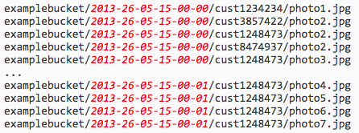
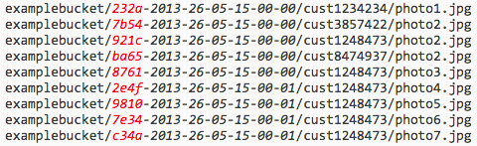
S3 Performance Considerations
Multi-part Upload
Request Rate and Object Keys
Add Hex Hash
Reverse Key Name with increasing sequence numbers

Slide 119
S3 Demo for
Versioning
Static Web Site Hosting
Enabling access logs
Enabling Server Side encryption

Slide 120
S3 as Data Lake
Decouples Data from Compute
Integrations with most AWS Services
Integrations with Open-source data processing frameworks
Cost-effective, HA, Scalability and Durability matches data lake requirements

Slide 121
Lets explore AWS S3 SDK Now
AmazonS3Client class
MakeBucket
Get
Put
List
Pre-signed URL
Data Encryption
Delete

Slide 122
S3 Lab using SDK

Slide 123
Module 6
Dynamodb

Slide 124
What is a database?
Technology adoption and hype curve

Slide 125
SQL vs. NoSQL
 | SQL database | NoSQL database
Type | Relational data retrieved with complex queries | Wide-column, document, keyvalue, graph
Schema | Fixed | Dynamic/Fixed
Scaling | Vertical | Horizontal
Transactions | Supported | Support varies
Consistency | Strong | Eventual and strong
Queries | Ad-hoc queries | Instantiated views
Query Type | Good for OLTP | Built for OLTP at scale

Slide 127
NoSQL Database

Slide 128
Workload Driven Data Store Selection
Hot Reads
Rich Search
Search
Cache
Blob Store
Logging
Data Tier
Key/value simple query
NoSQL
RDBMS
Data Warehouse
Analytics
Complex queries and transactions

Slide 129






AWS for the Data Tier
Hot Reads
Amazon ElastiCache
Rich Search
Logging
Amazon CloudSearch
Amazon S3
Data Tier
Amazon Redshift
Amazon Dynamodb
Key/value simple query
Analytics
Amazon RDS
Complex queries and transactions

Slide 130
What is Dynamodb?
A fully managed, Nosql database solution
No servers to manage
Predictable performance and seamless scalability
Consistent
Fully resilient and highly available
SSD storage
No practical storage limits
Deep integration with IAM
Characteristics like key-value and document store db’s.

Slide 131
What is Dynamodb?
Collection of Tables.
Courses
Students
Grades
Highest level structure
No Schema, except Keys
Performance is managed per table
Resources are allocated accordingly.
Role of Data Model

Slide 132
Amazon Dynamodb: Concepts
Tables
Items
Attributes
Attributes per item might differ
Partition Key (Hash Key)
Sort Key (Range Key)

Slide 133
Amazon Dynamodb: Data Model

Slide 134
Partition Key/Sort Key Example

Slide 135
Data Types

Slide 136
Attribute Types
Scalar
Single value: String, Number, Binary or Boolean
Set
Collection : [“apple”,”orange”,”grape”]
Same Type
Order not preserved
Document
List : [“apple”,”orange”,”grape”, 54]
May be of a different data type
Order is preserved
Map (JSON)
JSON, Lookup tables and dictionaries etc.

Slide 137
Table Creation Options

Slide 138
Demo and Lab

Slide 139
Amazon Dynamodb: Consistency Model
Uses SSD for storage
3 replicas across multiple data centres
Lets understand Eventual Consistency with an example
CAP
Eventual vs Strong
Use Strong consistency if required
Strongly consistent will cost more…

Slide 140
Amazon Dynamodb: Provisioned Throughput
Changeable
Caution when changing capacity

Slide 141
Amazon Dynamodb: Provisioned Throughput
RCU – up to 4KB of data
• WCU – up to 1KB of data
• Smaller operations are rounded
• Examples:
– 3KB Read = 3KB/4KB = 0.75 = 1 RCU
– 6KB Read = 6KB/4KB = 1.5 = 2 RCU
– 40KB Read = 40KB/4KB = 10 = 10 RCU
– 2.5KB Write = 2.5KB/1KB = 2.5= 3 WCU
• Eventually consistent reads use HALF of RCU

Slide 142
Calculation Examples

Slide 143
Demo

Slide 144
Amazon Dynamodb: Retrieving Items
GetItem
Input P-Key value AND S-Key value (if applicable) for an item
• Return all or set of attributes for a match
• Otherwise returns nothing
• By default eventual consistent
• --consistent-read

Slide 145
Amazon Dynamodb: Retrieving Items
Query
• Input a PK OR
• A PK AND SK value or, range of value
• Return all or set of attributes for a match
• Otherwise returns empty set
• By default eventually consistent
• --consistent-read
• Can filter on Non-Key values
• Any discarded values are still charged for
• Can query indexes

Slide 146
Amazon Dynamodb: Retrieving Items
Scan
• Table Name
• Default output is all items and attributes
• Filter possible but all data is read still
• Scans can be parallelized
• Returned results can be limited

Slide 147
Amazon Dynamodb: Retrieving Items
BatchGetItem
– 1 or max 100 items, 1 or more tables, max 16MB
– Provide the PK or PK/SK
– ValidationException in case you ask for 100+ items
– ProvisionedThroughputExceededException
– Allows filtering of attributes but you are still billed

Slide 148
Amazon Dynamodb: Retrieving Items
Writing an Item
• PutItem-
– Single ITEM add – v. inefficient
– Each request is 1KB minimum
– Each request has a transaction time
• BatchWriteItem
– Up-to 25 items, 400KB and 16MB still applies
– Each item is written separately – still have the per item waste
– Used in loops, with expo backoff…

Slide 149
Amazon Dynamodb: Retrieving Items
Batch Operations
• 1 or more tables
• PUT and DELETE
• Parallel- low latency/better performance
• Individual WCU
• DELETES cost 1 WCU
• 1 operation per item
• Entire operation will fail
– >25 items
– If key attributes don’t match

Slide 150
Demo and Lab
Working with Items/Queries for DynamoDB

Slide 151
Amazon Dynamodb: Secondary Indexes
Define alternate key to query with non-primary key attributes.
• Global Secondary Index (GSI)
• Local Secondary Index (LSI)

Slide 152
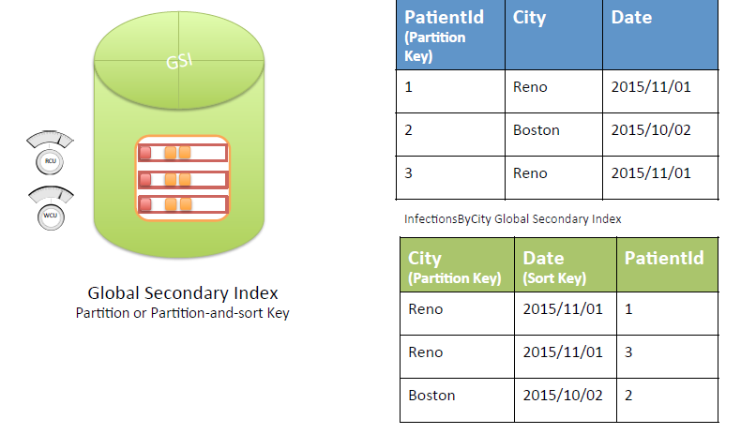
Amazon Dynamodb: Global Secondary Index

Slide 153
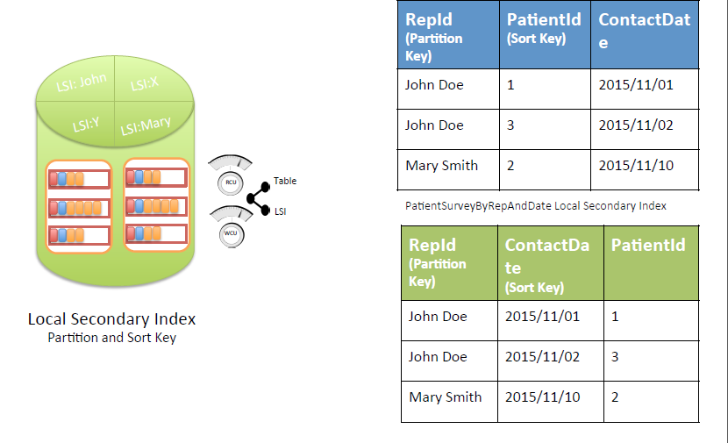
Amazon Dynamodb: Local Secondary Index

Slide 154
Amazon Dynamodb: GSI vs LSI
Local Secondary Index | Global Secondary index
Hash + Range key | Hash or Hash + Range
Has the same hash key as primary key. Range key defers | Hash key different that hash key of primary key
For each hash key total size of all indexed items <= 10GB | No Size restrictions
We can choose between eventual consistency or strong consistency | Supports only eventual consistency
Consumes read capacity units from table | Has own provisioning throughput and doesn’t use table’s throughput
Write to table consumes write capacity from table to update index
Can request other table aWributes which are not part of local index | Can only request aWributes which are part of global index

Slide 155
Amazon Dynamodb: Demo and Lab
Working with Secondary Indexes

Slide 156
Amazon Dynamodb: Partitions with Data Distribution
Data Distribution- PK

Slide 157
Amazon Dynamodb:
Data Distribution- PK/SK

Slide 158
Amazon Dynamodb:
Partitioning Math
Number of Partitions
By Capacity | (Total RCU / 3000) + (Total WCU / 1000)
By Size | Total Size / 10 GB
Total Partitions | CEILING(MAX (Capacity, Size))
In the future, these details might change…

Slide 159
Amazon Dynamodb:
Partitioning Example
Number of Partitions
By Capacity | (5000 / 3000) + (500 / 1000) = 2.17
By Size | 8 / 10 = 0.8
Total Partitions | CEILING(MAX (2.17, 0.8)) = 3
RCUs and WCUs are uniformly spread
across partitions
RCUs per partition = 5000/3 = 1666.67
WCUs per partition = 500/3 = 166.67
Data/partition = 10/3 = 3.33 GB

Slide 160
Amazon Dynamodb:
What causes throttling?
If sustained throughput goes beyond provisioned throughput per partition
Non-uniform workloads
Hot keys/hot partitions
Very large items
Mixing hot data with cold data
• Use a table per time period

Slide 161
Amazon Dynamodb:
From the example before:
Table created with 5000 RCUs, 500 WCUs
RCUs per partition = 1666.67
WCUs per partition = 166.67
If sustained throughput > (1666 RCUs or 166 WCUs) per key or partition, DynamoDB may throttle requests
Solution: Increase provisioned throughput

Slide 162
Amazon Dynamodb:
What does bad NoSQL looks like?
Heat
Partitioning
Time

Slide 163
Getting The Most Out Of Dynamodb Throughput
“To get the most out of DynamoDB throughput, create tables where the
partition key element has a large number of distinct values, and values
are requested fairly uniformly, as randomly as possible.”
—DynamoDB Developer Guide
Space: Access is evenly spread over the key-space
Time: Requests arrive evenly spaced in time

Slide 164
Amazon Dynamodb: Much Better Picture

Slide 165
DynamoDB Streams and AWS Lambda

Slide 166
Amazon Dynamodb: Streams
Streams contain a log of changes to a table
UserID | Fav Exercise
Jane | Walking
UserID | Fav Exercise
Jane | Spinning
Asynchronous update to stream
Shard1
Shard2
Name=Jane, FavoriteExercise=Walking
Name=Jane, FavoriteExercise=Spinning
Shard4
Shard5

Slide 167
Amazon DynamoDB: Monitoring And Alerting
ConsumedReadCapacityUnits
• ConsumedWriteCapacityUnits
• ProvisionedReadCapacityUnits
• ProvisionedWriteCapacityUnits
• ThrottledRequests
• ReadThrottleRequest and WriteThrottleRequest
• Monitoring
– Table
– GSI
– Stream
https://docs.aws.amazon.com/amazondynamodb/latest/developerguide/metrics-dimensions.html

Slide 168
Amazon Dynamodb: DynamoDB Local
Downloadable version of DynamoDB.
Write and test apps without accessing DDB service.
DDB Local is self contained within your computer.
Lets setup DynamoDB local and run our example.

Slide 169
Amazon Dynamodb: Object Mapper
“DynamoDBMapper eliminates the need for application-level data conversions and custom middleware solutions by using Plain Old Java Objects (POJOs) to store and retrieve Amazon DynamoDB data”

Slide 170
Amazon Dynamodb: Access Control
Account Root User
• IAM User
• IAM Role
– Federated Access
– Cross Account Access
– Service Access
– Web Identities
• Policies
• Groups

Slide 171
Amazon Dynamodb: Access Control
Policy: Example

Slide 172
Amazon Dynamodb: Access Control
Policy: Example

Slide 173
Amazon Dynamodb: Access Control
Policy: Example

Slide 174
Amazon Dynamodb: Document API
Document API produce code that is both easy to write and read.
Document API makes storing, retrieving and converting the document back to JSON an easy task.

Slide 175
Amazon Dynamodb: Document API

Slide 176
Amazon Dynamodb: Data Modeling Considerations
What data groups exist in the system?
• When will data be accessed?
• What access patterns will the data have?
• How will the data grow over time?
• Will all data in time series have equal access?
• What operations will be run against the data?
• Are different perspectives on data needed?
• What are the batch/real-time processing needs?

Slide 177
Module 7
AMAZON Athena

Slide 178

Amazon Athena
Amazon Athena is an interactive query service that makes it easy to analyze data in Amazon S3 using standard SQL. Athena is serverless, so there is no infrastructure to manage, and you pay only for the queries that you run.
Interactive query service on Amazon S3
Supports cross-region queries
Supports ANSI SQL operators and functions
Serverless

Slide 179

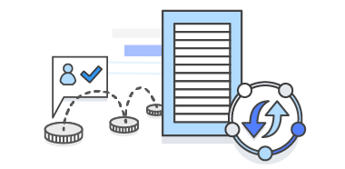

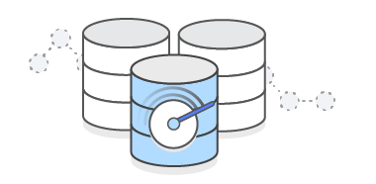
Amazon Athena: Benefits
Start Querying Instantly
Serverless, No ETL
Pay Per Query
Only pay for data scanned
Uses Presto with ANSI SQL support
Works with a variety of standard data formats, including CSV, JSON, ORC, Avro, and Parquet
Executes queries in parallel
Interactive performance even for large datasets

Slide 180
Amazon Athena
Presto for SQL Queries
In-memory distributed query engine
ANSI-SQL compatible with extensions
Hive for DDL functionality
Complex data types
Supports multiple formats
Supports data partitioning

Slide 181
Amazon Athena: Use cases
Log Analytics
Application logs
Apache web logs
Data Discovery
Integrated with Amazon Quicksight
Use S3 as a Data Lake
Amazon Athena for ad hoc queries
Amazon Redshift for historical analysis
Amazon EMR for ETL and analytics

Slide 182
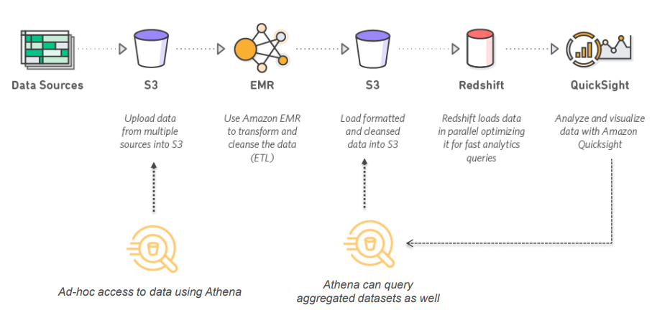
Amazon Athena: Data Lake Pipeline

Slide 183
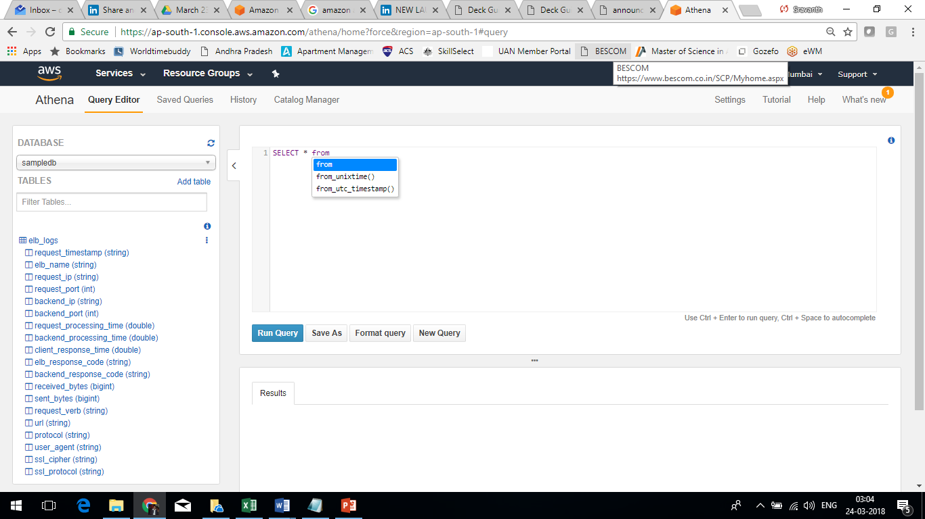
Amazon Athena: Console Interface
Autocomplete
Functionality
Simple query editor
Tables and Columns

Slide 184
Amazon Athena: Tables
Create Table Statements (or DDL) are written in Hive
• High degree of flexibility
• Schema on Read
• Hive is SQL like but allows other concepts such “external tables” and partitioning of data
• Data formats supported – JSON, TXT, CSV, TSV, Parquet and ORC (via Serdes)
• Data in stored in Amazon S3
• Metadata is stored in an a metadata store

Slide 185
Amazon Athena: Internal Metadata Store
Stores Metadata
• Table definition, column names, partitions
• Highly available and durable
• Requires no management
• Access via DDL statements
• Similar to a Hive Metastore

Slide 186
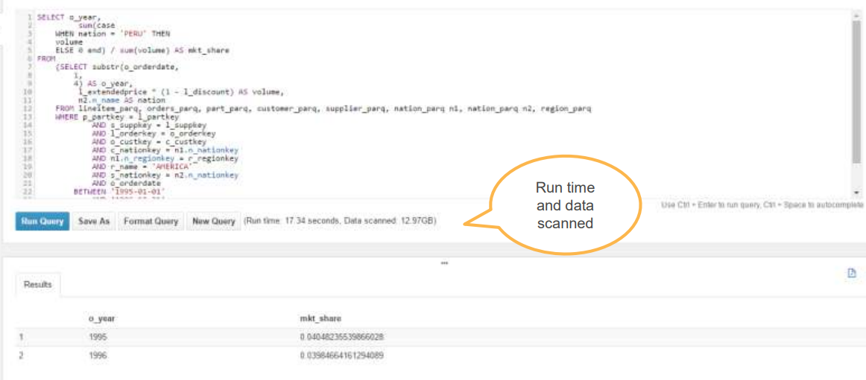
Amazon Athena: Running Query
Run time and data scanned

Slide 187
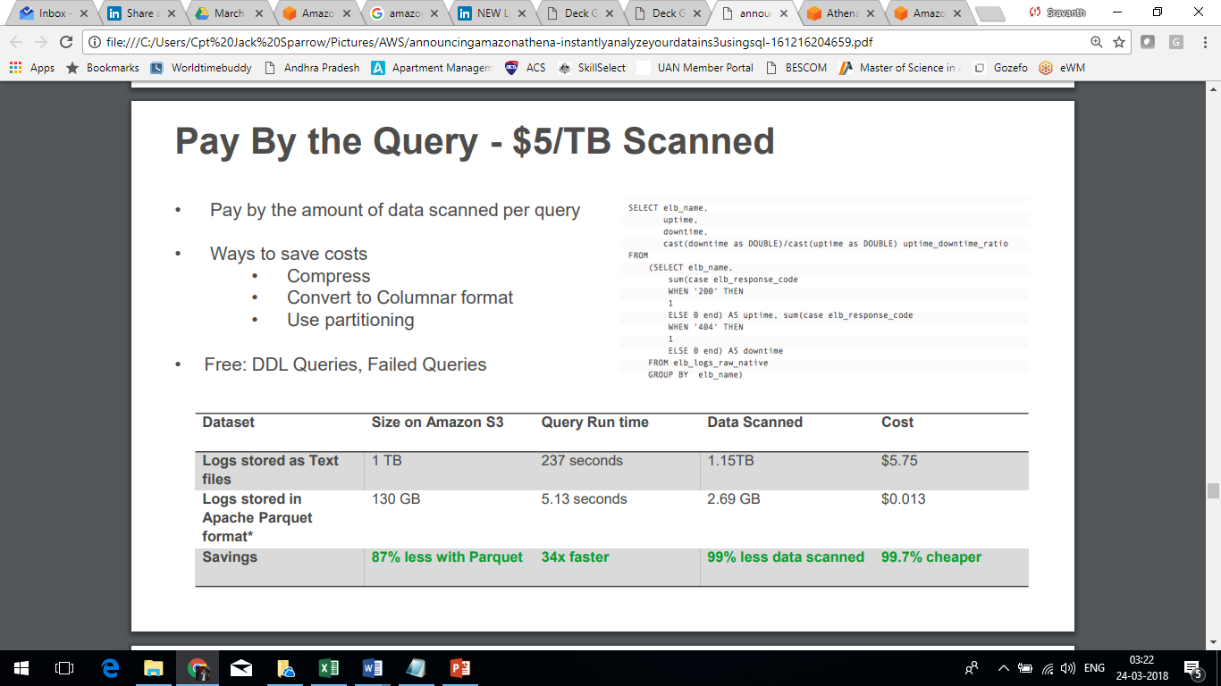
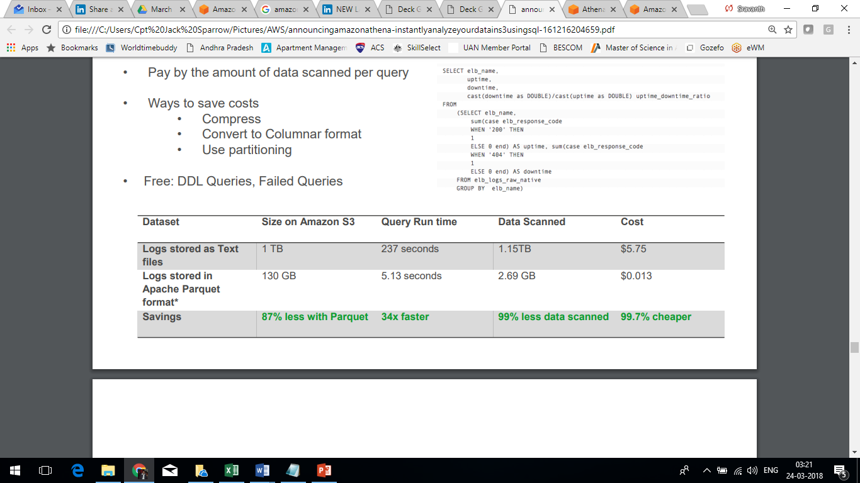
Amazon Athena: Cost
Pay by the query - $5TB Scanned
Pay by the amount of data scanned per query
• Ways to save costs
Compress
Convert to Columnar format
Use partitioning
• Free: DDL Queries, Failed Queries

Slide 188
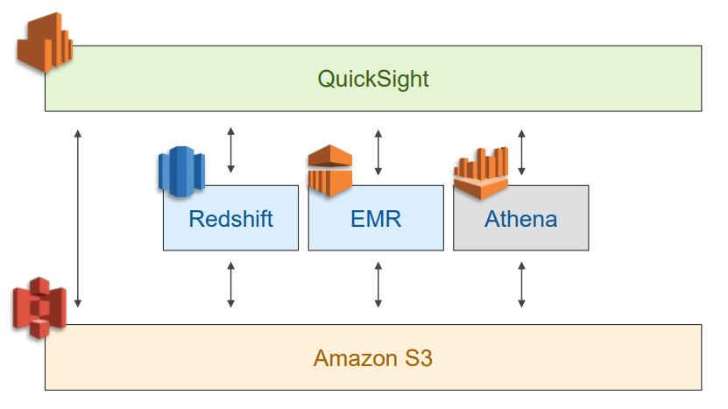
Amazon Athena: With Redshift and EMR

Slide 189
Amazon Athena: Demo and Lab

Slide 190
Module 8
AWS EMR

Slide 191

AWS EMR: Introduction
Amazon EMR provides a managed Hadoop framework that makes it easy, fast, and cost-effective to process vast amounts of data across dynamically scalable Amazon EC2 instances.
Managed cluster
Run popular distributed frameworks such as Apache Spark, HBase, Presto, and Flink
Interact with data in other AWS data stores such as Amazon S3 and Amazon DynamoDB
Launch a cluster in minutes
Cost effective
Provision one, hundreds, or thousands of compute instances to process data at any scale
Automatically configure Amazon EC2 firewall settings that control network access to instances

Slide 192
AWS EMR: Benefits
Easy to Use
Low Cost
Elastic
EMR
Secure
Reliable
Flexible

Slide 193
AWS EMR: Benefits
Easy to Use
Low Cost
Configure and launch instances in minutes
No need to
Provision nodes
Set-up clusters
Configure Hadoop
Tune clusters
Elastic
EMR
Secure
Reliable
Flexible

Slide 194
AWS EMR: Benefits
Easy to Use
Low Cost
Elastic
EMR
Secure
Data can be processed at scale
Respond to increase in workloads by dynamically scaling the cluster size
Scale storage capacity based on needs
Reliable
Flexible

Slide 195
AWS EMR: Benefits
Easy to Use
Low Cost
Simplify tuning and debugging activities
Automated monitoring, identification and replacement of poorly performing nodes
Elastic
EMR
Secure
Reliable
Flexible

Slide 196
AWS EMR: Benefits
Easy to Use
Low Cost
No upfront hardware investment
Pay only for what you use
Combine with EC2 Spot and Reserved Instances
Elastic
EMR
Secure
Reliable
Flexible

Slide 197
AWS EMR: Benefits
Easy to Use
Low Cost
Elastic
EMR
Secure
Launch instances in VPC
Security groups control access to instances
Use encryption including Amazon S3 SSE and CSE with EMRFS
Use key management technologies
Reliable
Flexible

Slide 198
AWS EMR: Benefits
Easy to Use
Low Cost
Easy to install ecosystem applications
Cluster configuration can be customized
Different instance type for different workloads
Elastic
EMR
Secure
Reliable
Flexible

Slide 199
How Hadoop Handles Your Input Data
1 GB
1 GB
READ!
1GB file with a split size of 64 MB = 15 parallel HTTP requests
If you use Amazon S3 to store your data:
When a processing job starts, Hadoop splits the data by reading your files in multiple HTTP range requests.
The split size that Hadoop uses to read data from Amazon S3 varies depending on the Amazon EMR version being used (newer versions have larger split sizes).
If you use HDFS to store your data, your data is automatically split by Hadoop.
Notes:
Before processing it, Hadoop splits your data into multiple chunks. If you're using HDFS to store your data, your data is already split by Hadoop automatically. If you're using Amazon S3 to store your data, when a processing job is started, Hadoop must first split the data by reading your files in multiple HTTP range requests. The split size that Hadoop uses to read data from Amazon S3 varies depending on the Amazon EMR version being used (newer versions have larger split sizes).

Slide 200
Best Practices
Aggregate files
Control aggregation at ingestion
Use compression
Intermediate and output data compression
Use Data partitioning

Slide 201
Data Compression Algorithms
Compression | Extension | Splittable | Encoding/ Decoding Time | Final file size
Snappy | snappy | No
bzip2 | bz2 | Yes
LZO | lzo | Yes, if indexed
gzip | gz | No
(smaller is better)
Notes:
gzip is supported by Hadoop natively and is based on the DEFLATE algorithm (a combination of LZ77 and Huffman Coding).
An LZO file is composed of many smaller (~245K) blocks of compressed data, which allows jobs to be split along boundaries. It decompresses nearly twice as quickly as gzip, which enables it to keep up with most hard drive read speeds; however, it doesn't compress as well as gzip (files will be around 50% larger than gzip compressed versions).
bzip2 is a freely available, patent-free, high-quality data compressor. It typically compresses files to within 10% to 15% of the best available techniques (the PPM family of statistical compressors), and is faster at compression and much faster at decompression.
Snappy aims for very high speeds and reasonable compression. It compresses files that are 20–100% larger than most comparable compression types and compresses at much higher speeds than most similar solutions.

Slide 202

On-prim Hadoop vs EMR
Amazon EMR and the AWS big data ecosystem:
Offer scalable solutions for a vast array of big data workloads.
Require no hardware investment and minimal personnel.
Capacity can be quickly and automatically scaled out or in based on need, schedule, or both.
Encourage innovation by enabling experimentation and ad hoc analysis.
Reduce the need for configuration, management, maintenance, and administration personnel.
Allow you to integrate workflows via the service dashboards and APIs.
Include integrated monitoring support with free CloudWatch metrics.
Allow simple management of storage with multiple scalable options such as HDFS, S3, and DynamoDB.

Slide 203
Benefits of EMR
Elastic
Easy
Low cost
Reliable
Secure
Flexible
Multiple data store service
AWS services integration
Notes:
Channel 4

Slide 204

Amazon EMR: Architecture
Master node:
Manages resources of cluster
Schedules jobs on worker instances
Master node
Core nodes:
CPU
RAM
HDFS storage
HDFS
HDFS
Task nodes:
CPU
RAM
Core nodes
Task nodes

Slide 205
Amazon EMR: Architecture
Master node:
Contains one master node
Controls the cluster
Runs ResourceManager daemon:
Runs NameNode daemon:
Monitors health of core, task nodes
Master node
Core instance group:
Contains all core nodes along with HDFS storage
At least one core instance must be running
Includes DataNode and NodeManager daemons
Task instance group:
Add task nodes when you launch an EMR cluster, or add a task instance group to a cluster that already exists
Does not include or add storage to the instance group
Only includes NodeManager daemon
HDFS
HDFS
Core nodes
Task nodes

Slide 206
Amazon EMR: Architecture
Amazon EMR service architecture consists of several layers, each of which provides certain capabilities and functionality to the cluster.
Storage
Cluster resource management
Data processing frameworks
Applications and programs

Slide 207
Amazon EMR: Architecture - Storage
The storage layer includes the different file systems that are used with your cluster.
Hadoop Distributed File System (HDFS)
EMR File System (EMRFS)
Local File System

Slide 208
Amazon EMR: Architecture - Cluster Resource Management
The resource management layer is responsible for managing cluster resources and scheduling the jobs for processing data.
YARN (Yet Another Resource Negotiator) to centrally manage cluster resources
Keeps the cluster healthy, and communicates with the Amazon EMR service
Amazon EMR supports other frameworks and applications that are offered in Amazon EMR that do not use YARN as a resource manager.

Slide 209
Amazon EMR: Architecture - Data Processing Frameworks
The data processing framework layer is the engine used to process and analyze data.
The framework
Depends on your use case
Impacts the languages and interfaces available from the application layer
The main processing frameworks available for Amazon EMR are Hadoop MapReduce and
Spark.

Slide 210
Amazon EMR: Architecture - Applications and Programs
Amazon EMR supports applications such as Hive, Pig, and the Spark Streaming library to provide many capabilities:
Using higher-level languages to create processing workloads,
Leveraging machine learning algorithms,
Making stream processing applications, and
Building data warehouses.
Amazon EMR supports various libraries and languages to interact with the applications that you run in Amazon EMR, such as Java, Hive, or Pig with MapReduce or Spark Streaming, Spark SQL, MLlib, and GraphX with Spark.

Slide 211
Why EMR Vs Running Hadoop on EC2?
Decouple compute and storage
Auto Scaling (Task Nodes)
Dynamic Orchestration
Faster access to data in S3
High Availability of Slave/Master
Management Console
Cost
Management Cost
Notes:
Don’t want to invest time in managing and updating your distribution then AWS EMR must be the best option for you.
Data is stored in S3 and you want to run the occasional job on the data and dump the results back to S3 then it must make sense that you use Elastic Map/Reduce (EMR).
Need to run a full Hadoop/HBase stack 24×7 and have custom data format (other than S3) then Cloudera must be the best option for you.
Need to debug the issues and need to integrate it with other software then Cloudera must be the best option for you.

Slide 212
How to Use Amazon EMR?
Step 1
Develop your data processing application
Step 2
Upload your application and data to Amazon S3
Step 3
Configure and launch your cluster
Step 4
Monitor the cluster (Optional)
Step 5
Retrieve the output

Slide 213
Launch an Amazon EMR Cluster
Three ways to launch EMR clusters:
AWS Management Console
AWS CLI
AWS API

Slide 214
Amazon EMR
Demo

Slide 215
Apache Hadoop Programming Frameworks
Basics of Programming Frameworks
Typical three-tiered structure
Language
Interpreter
Engine

Slide 216
Popular Frameworks on Hadoop
Hive
Presto
Pig
Hue
Spark

Slide 217
Apache Hive Framework on Hadoop
By default, Hive runs on the MapReduce engine, however there are popular resources available for running it on the Spark or Tez engines instead.
Language: HiveQL
Interpreter: Hive
Engine: MapReduce, Spark, or Tez

Slide 218
Apache Hive Framework on Hadoop
Apache Hive provides HiveQL for querying and managing large datasets in distributed storage (S3, HDFS, Hbase and so on)
Provides data warehousing-style capabilities
Facilitates faster access to ad hoc query data for reporting
Imposes provided schema on input data, at the run-time
Leverages Tez for query execution by default
Executes on Apache MapReduce

Slide 219
Popular Frameworks on Hadoop
Hive
Presto
Pig
Hue
Spark

Slide 220
Presto Framework on Hadoop
Presto has essentially a flat structure, where SQL queries are run directly against the Presto engine.
Language: SQL
Engine: Presto

Slide 221
Presto Framework on Hadoop
Faster querying for interactive queries
Does not run on MapReduce
Operates in-memory and based on its own engine

Slide 222
Popular Frameworks on Hadoop
Hive
Presto
Pig
Hue
Spark

Slide 223
Apache Pig Framework on Hadoop
Executes on MapReduce, can be configured on Tez
Accepts inputs in the form of unstructured and semi-structured data
Pig script can transform data
Supports relational operations such as nested, joins and grouping
Language: Pig Latin
Interpreter: Pig
Engine: MapReduce, Tez

Slide 224
Popular Frameworks on Hadoop
Hive
Presto
Pig
Hue
Spark

Slide 225
Hue

Slide 226
Popular Frameworks on Hadoop
Hive
Presto
Pig
Hue
Spark

Slide 227
Apache Spark
Integration with Hadoop
Spark’s framework is built on top of the Hadoop Distributed File System (HDFS).
Faster
Spark also starts with the same concept of being able to run MapReduce jobs except that it first places the data into RDDs (Resilient Distributed Datasets)
Real time stream processing
Spark helps to analyse real time data as and when it is collected. Applications are fraud detection, electronic trading data, log processing in live streams (website logs), etc.

Slide 228
Apache Spark
Suitable for batch, interactive and streaming data sources
Supports text and Hadoop file formats
Data sources can be HDFS, Amazon S3 and other databases
SPARK Programming Model
Read-only distributed collections of objects that are cached in-memory
Allows apps to keep working sets in memory for efficient reuse
Retain properties of MapR such as fault tolerance, data locality and scalability

Slide 229
SPARK Programming Model
RDD is created from data on stable storage, then use transformations or actions.
Map/filter/groupby/join transformations
Count/reduce/collect/save actions return results
Spark builds Directed Acyclic Graph of stages for execution
Enables tracking
Minimal I/O by storing DataFrames in memory
Partition-aware to avoid network-intensive shuffle

Slide 230
Apache SPARK SQL
For use of Spark with structured data
Data on-disk or in-memory can be processed
Utilze Hive metastores, SerDes and UDFs
Compatible with Hive, Avro, Parquet, ORC, JSON, JDBC and other sources
Connect via JDBC or ODBC connectors
Meta
Store
SerDes
UDFs
HiveQL
Spark SQL
Spark

Slide 231
Spark Streaming: Develop Stream Processing Applications
Build scalable, fault-tolerance streaming applications through high-level operators.
Requires no extra code to recover lost work and operating state when a task fails
Write streaming jobs with Spark’s language API
Supports Scala, Java and Python
Included with any Spark installation (including Amazon EMR)

Slide 232
SparkML: Machine Learning with Spark
Scalable, distributed machine learning algorithm library for Spark
Include with any Spark installation (including Amazon EMR)
Includes a wide variety of machine learning algorithms:
Classification
Regression
Collaborative filtering
Clustering
Decomposition
SparkML apps can be written in Java, Scala, Python or SparkR

Slide 233
Managing Amazon EMR Costs
Hourly charges are inclusive of:
Amazon EC2 instance type
Amazon EMR upcharge
Charges vary with instance type.
Amazon S3, Dynamodb and Amazon RDS have additional costs
Data transfer out is charged.

Slide 234
Managing Amazon EMR Costs
Factors which determine the cost of instance type:
Region
Pricing Model (On-demand, reserved instances or spot)
EC2 Instance size
Charges are applicable per instance hour and not per cluster.
10 nodes for 10 hours costs the same as 100 nodes for 1 hour
Per instance hour is calculated when instances are running

Slide 235
Managing Amazon EMR Costs
Identify if clusters can be transient vs. long running
An intelligent mix of transient and long running clusters can lower costs
Add or remove core or task nodes as per the changing workload

Slide 236
Overview of Amazon EMR security
Security of the cloud is the responsibility of AWS and security within the cloud is a joint effort between the customer and AWS.
Best Practices
Access based on AWS Account ID
Every API request to Amazon EMR to be authenticated
Default Security Groups
Use cluster tags to further enable fine-grained access control

Slide 237
Cloudera vs Hortonworks vs EMR
Tech Stack
Ease of installation
Updates
Proprietary softwares
License
SQL Interface
Focus/Target
Security Tools
HA

Slide 238
Module 9
AWS glue

Slide 239
AWS Glue: Overview
AWS Glue is a fully managed ETL (extract, transform, and load) service
Simple and cost-effective
Clean, enrich and move data reliably between various data stores
AWS Glue consists of:
A central metadata repository known as the AWS Glue Data Catalog,
An ETL engine that automatically generates Python or Scala code, and
A flexible scheduler that handles dependency resolution, job monitoring, and retries.
AWS Glue is serverless, so there’s no infrastructure to set up or manage.

Slide 240
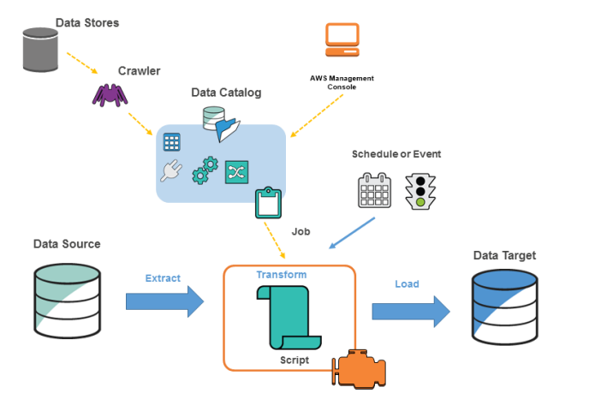
AWS Glue: Components
1
AWS Glue Console
AWS Glue Data Catalog
AWS Glue Crawlers and Classifiers
AWS Glue ETL Operations
The AWS Glue Jobs System
3
2
5
4

Slide 241
AWS Glue: Components
AWS Glue Console
Define and orchestrate your ETL workflow
Perform the following tasks:
Define AWS Glue objects such as jobs, tables, crawlers, and connections
Schedule when crawlers run
Define events or schedules for job triggers
Search and filter lists of AWS Glue objects
Edit transformation scripts

Slide 242
AWS Glue: Components
AWS Glue Data Catalog
Persistent metadata store
Each AWS account has one AWS Glue Data Catalog
Contains table definitions, job definitions, and other control information to manage your AWS Glue environment
The Data Catalog is a drop-in replacement for the Apache Hive Metastore.

Slide 243
AWS Glue: Data Catalog
Table = Metadata definition that represents data
Crawler = A program that connects to a data store (source or target), progresses through a prioritized list of classifiers
Classifier = Determines the schema of data
Connection = Contains the properties that are required to connect to the data store
Database = A set of associated table definitions organized into a logical group in AWS Glue
Job = The business logic that is required to perform ETL work
Script = Code that extracts data from sources, transforms it, and loads it into targets
Transform = The code logic that is used to manipulate data into a different format
Trigger = Initiates an ETL job. Triggers can be defined based on a scheduled time or an event

Slide 244
AWS Glue: Components
AWS Glue Crawlers and Classifiers
Scan data in all kinds of repositories
Classify and extract schema information from data
Store the metadata automatically
From there it can be used to guide ETL operations.

Slide 245
AWS Glue: Components
AWS Glue ETL Operations
Autogenerate Scala or PySpark (the Python API for Apache Spark) scripts
For example, you can extract, clean, and transform raw data, and then store the result in a different repository, where it can be queried and analyzed.
Such a script might convert a CSV file into a relational form and save it in Amazon Redshift.

Slide 246
AWS Glue: Components
AWS Glue Jobs System
Provides managed infrastructure to orchestrate ETL workflow
Create jobs in AWS Glue that automate the scripts used to extract, transform, and transfer data to different locations
Schedule jobs or trigger events

Slide 247
AWS Glue: Securing with IAM
Steps to set-up basic permissions for AWS Glue
Create an IAM Policy for the AWS Glue Service: Create a service policy that allows access to AWS Glue resources
Create an IAM Role for AWS Glue: Create an IAM role, and attach the AWS Glue service policy and a policy for your Amazon Simple Storage Service (Amazon S3) resources that are used by AWS Glue
Attach a Policy to IAM Users That Access AWS Glue: Attach policies to any IAM user that signs in to the AWS Glue console
Create an IAM Policy for Notebooks: Create a notebook server policy to use in the creation of notebook servers on development endpoints
Create an IAM Role for Notebooks: Create an IAM role and attach the notebook server policy

Slide 248
AWS Glue: Setting Up Environment
To run extract, transform, and load (ETL) jobs, AWS Glue must be able to access your data stores.
If a job doesn't need to run in virtual private cloud (VPC) subnet—for example, transforming data from Amazon S3 to Amazon S3—no additional configuration is needed.
If a job needs to run in customer VPC subnet, AWS Glue sets up elastic network interfaces that enable the jobs to connect securely to other resources within VPC.

Slide 249
AWS Glue: Setting Up Environment
AWS Glue within Customer VPC Subnet
Each ENI is assigned a private IP from the subnet pool
Specified security groups apply
All JDBC data stores must be available from the VPC subnet
Access to Amazon S3 requires VPC Service endpoint
Access to Internet requires Network Address Translator (NAT) gateway

Slide 250
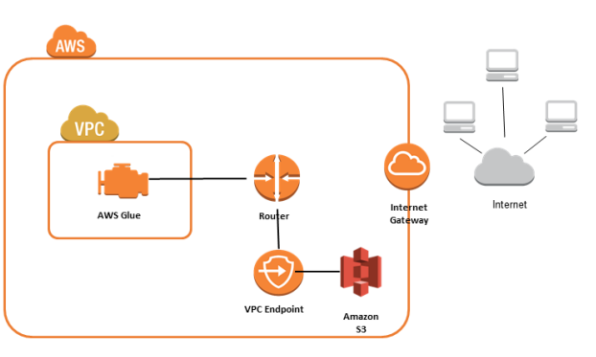
AWS Glue: Pointing to Specific Data Stores and Endpoints
Amazon VPC Endpoints for Amazon S3
To set up access for Amazon S3
Sign in to the AWS Management Console and open the Amazon VPC console at https://console.aws.amazon.com/vpc/
In the left navigation pane, choose Endpoints.
Choose Create Endpoint, and follow the steps to create an Amazon S3 endpoint in your VPC.

Slide 251
AWS Glue: Pointing to Specific Data Stores and Endpoints
Setting Up a VPC to Connect to JDBC Data Stores
To enable AWS Glue components to communicate:
Set up access to data stores, such as Amazon Redshift and Amazon RDS
Specify a security group with a self-referencing inbound rule for all TCP ports
Let us see an example in the next few slides.

Slide 252
AWS Glue: Demo
To set up access for Amazon Redshift data stores
Sign in to the AWS Management Console and open the Amazon Redshift console
In the left navigation pane, choose Clusters.
Choose the cluster name that you want to access from AWS Glue.
In the Cluster Properties section, choose a security group in VPC security groups to allow AWS Glue to use.
Choose the security group to modify and navigate to the Inbound tab.
Add a self-referencing rule to allow AWS Glue components to communicate. Specifically, add or confirm that there is a rule of Type All TCP, Protocol is TCP, Port Range includes all ports, and whose Source is the same security group name as the Group ID.

Slide 253
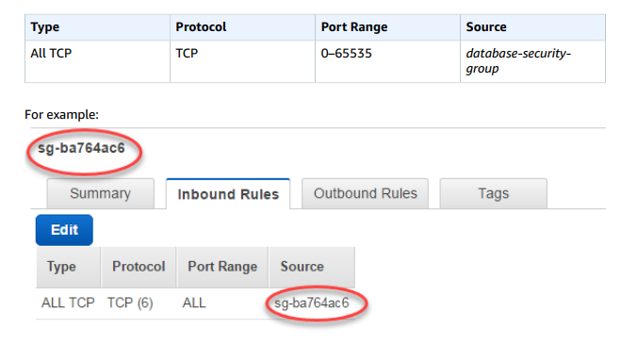
AWS Glue: Demo
To set up access for Amazon Redshift data stores

Slide 254
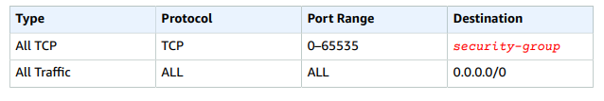
AWS Glue: Demo
To set up access for Amazon Redshift data stores
Add a rule for outbound traffic also.

Slide 255
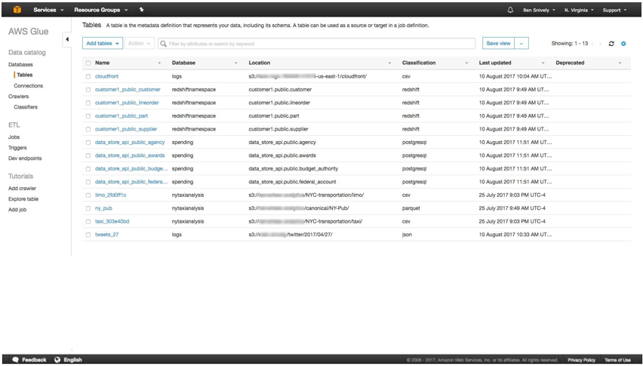
AWS Glue: How it Works?
Step 1: Build your Data Catalog
First, use the AWS Management Console to register your data sources.
AWS Glue will crawl your data sources and construct your Data Catalog using pre-built classifiers for many popular source formats and data types, including JSON, CSV, Parquet, and more.

Slide 256
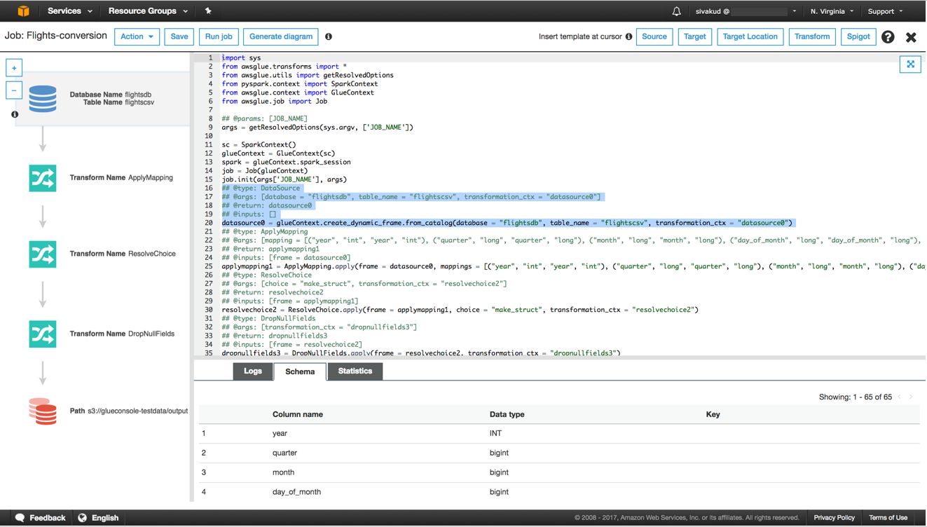
AWS Glue: How it Works?
Step 2: Generate and Edit Transformations
Next, select a data source and data target.
AWS Glue will generate ETL code in Scala or Python to extract data from the source, transform the data to match the target schema, and load it into the target.
You can edit, debug and test this code via the Console, in your favorite IDE, or any notebook.

Slide 257
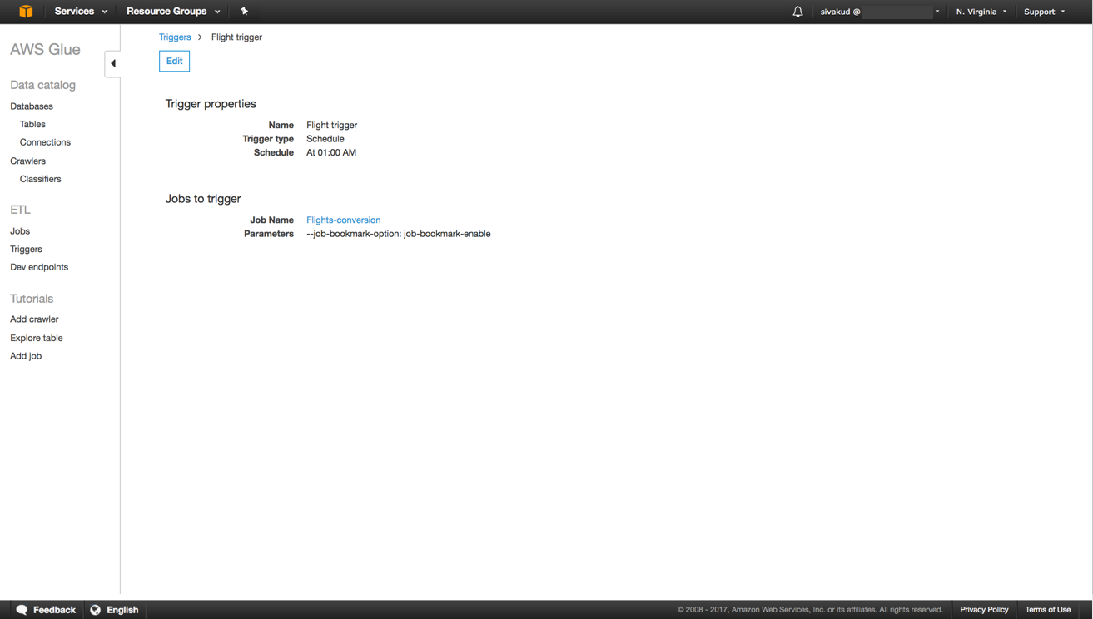
AWS Glue: How it Works?
Step 3: Schedule and Run Your Jobs
AWS Glue makes it easy to schedule recurring ETL jobs, chain multiple jobs together, or invoke jobs on-demand from other services like AWS Lambda.
AWS Glue manages the dependencies between your jobs, automatically scales underlying resources, and retries jobs if they fail.

Slide 258
AWS Glue: How it Works?
Demo

Slide 259
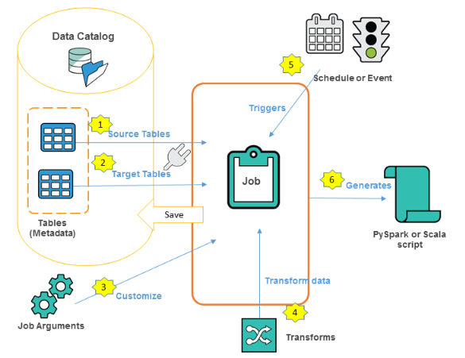
AWS Glue: Authoring Jobs
A job is the business logic that performs the extract, transform, and load (ETL) work in AWS Glue.
Choose the data sources for the job.
Choose the data targets of the job.
Customize the job-processing environment by providing arguments for job and generated script.
Specify how the job is invoked, either on demand, by a time-based schedule, or by an event.
Based on the input, AWS Glue generates a PySpark or Scala script.

Slide 260
AWS Glue: Editing Scripts
A script contains the code that extracts data from sources, transforms it, and loads it into targets. AWS Glue runs a script when it starts a job.
You can edit a script in the AWS Glue console. When you edit a script, you can add sources, targets, and transforms.

Slide 261
AWS Glue: Editing Scripts
Script Editor
Allows insert, modify, and delete sources, targets and transforms
Displays both the script and a diagram
To create a diagram for the script, choose Generate diagram
The Logs tab shows the logs that are associated with your job as it runs. The most recent 1,000 lines are displayed.
The Schema tab shows the schema of the selected sources and targets, when available in the Data Catalog.

Slide 262
AWS Glue: Logging and Monitoring
Monitoring is an important part of maintaining the reliability, availability, and performance of AWS Glue.
AWS provides:
Monitoring tools that you can use to watch AWS glue
Report when something is wrong, and
Take action automatically when appropriate

Slide 263
Module 10
AWS Redshift

Slide 264
What is Data Warehouse and Goals?
A data warehouse is:
A central repository of business data from disparate sources.
A type of relational database that enables analysis of data.
A collection of approved and trusted historical corporate data.
Goals
Provide access to corporate or organizational data.
Ensure consistency and quality of the data.
Enable analysis of data in different ways based on measurements that are defined by the business.
Integrate with query, analysis, visualization, and reporting tools.

Slide 265
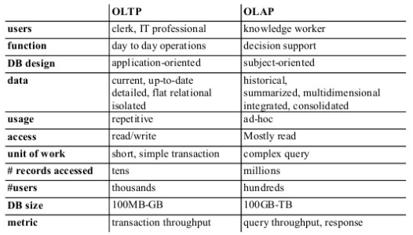
OLTP vs OLAP

Slide 266
What is Redshift?
Relational Data Warehouse
Fully Managed
Massively Parallel
Petabyte scale
Columnar Store
Targeted Data Compression
Cost Effective ($1000/TB/Year)
HDD and SSD platform

Slide 267
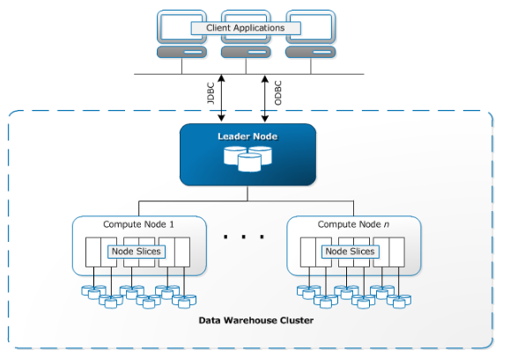
Redshift Architecture

Slide 268
Architecture Components
Client Applications
Cluster
Leader Node
Compute Nodes
Node Slices
Internal Network

Slide 269
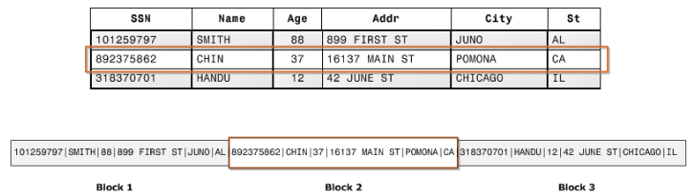
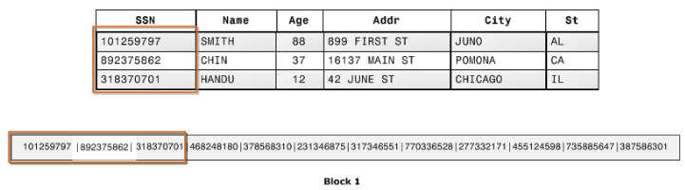
Columnar Storage

Slide 270
Redshift and Other AWS Services
Moving Data Between Amazon Redshift and Amazon S3
Using Amazon Redshift with Amazon DynamoDB
Moving Data between Amazon EMR and Redshift
Automating Data Loads Using AWS Data Pipeline
Migrating Data Using AWS Database Migration Service (AWS DMS)

Slide 271
Launching Cluster
Identify Cluster requirements
Network Settings
VPC
Leader Node run in customer VPC
Compute nodes run in AWS internal VPC
Cluster subnet group
Cluster parameter group
Encryption Settings

Slide 272
Launching Cluster
Launch Cluster
Configure Client connectivity
Monitoring and Auditing
Access Control (Permissions)
Load Data
Start Analyzing

Slide 273
Demo/Lab
Creating and using a Redshift Cluster

Slide 274
Module 11
AWS Data pipeline

Slide 275
Amazon DataPipeline
Can use to automate the movement and transformation of data
You define data-driven workflows, so that tasks can be dependent on the successful completion of previous tasks.
Components of Data Pipeline
Pipeline definition: logic for your data management.
A pipeline schedules and runs tasks.
Task Runner: polls for tasks and performs those tasks.

Slide 276
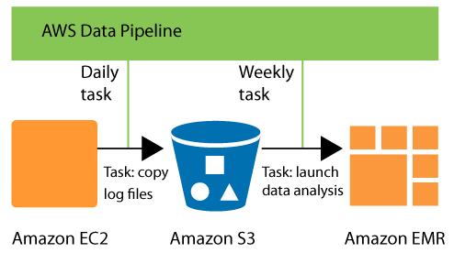
Example

Slide 277
DataPipeline works with
Compute Services
EC2
EMR
Data Services
DynamoDB
Redshift
S3
RDS

Slide 278
DataPipeline Concepts
Pipeline Definition
Pipeline Components and Instances
Task Runners
Data Nodes
Activities
Preconditions
Actions
Resorces

Slide 279
Pipeline Definition
Names, locations, and formats of your data sources
Activities that transform the data
The schedule for those activities
Resources that run your activities and preconditions
Preconditions that must be satisfied before the activities can be scheduled
Ways to alert you with status updates as pipeline execution proceeds

Slide 280
Data Nodes
The location of input data for a task or the location where output data is to be stored.
Activities
A definition of work to perform on a schedule using a computational resource and typically input and output data nodes.
Preconditions
A conditional statement that must be true before an action can run.
Scheduling Pipelines
Defines the timing of a scheduled event, such as when an activity runs.
Resources
The computational resource that performs the work that a pipeline defines.
Actions
An action that is triggered when specified conditions are met, such as the failure of an activity.

Slide 281
Demo: Export MySql Data to S3
Notes:
https://docs.aws.amazon.com/datapipeline/latest/DeveloperGuide/dp-console-manual.html
https://docs.aws.amazon.com/datapipeline/latest/DeveloperGuide/dp-copydata-mysql-console.html

Slide 282
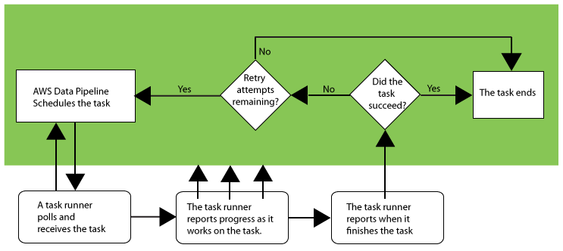
TaskRunner

Slide 283
Schedule
On-Demand
The option for a pipeline to be run on pipeline activation. The pipeline is run one time in response to an activation request.
Schedule
Periodic pipeline component scheduling
BackFill Tasks
When you define a pipeline with a scheduled start time for the past, AWS Data Pipeline backfills the tasks in the pipeline
Protecting against overriding data
s3://myBucket/#{@scheduledStartTime}

Slide 284
Data Nodes
DynamoDBDataNode
SqlDataNode
S3DataNode
RedshiftDataNode

Slide 285
Activities
CopyActivity
EmrActivity
HiveActivity
PigActivity
RedshiftCopyActivity
ShellCommandActivity
SQLActivity

Slide 286
Preconditions
System-Managed
DynamoDBDataExists
DynamoDBTableExists
S3KeyExists
S3PrefixNotEmpty
User-Managed
Exists
ShellCommandPrecondition

Slide 287
Resources
Ec2Resource
An EC2 instance that performs the work defined by a pipeline activity.
EmrResource
An Amazon EMR cluster that performs the work defined by a pipeline activity, such as EmrActivity.

Slide 288
Action
SnsAlarm
An action that sends an SNS notification to a topic based on onSuccess, OnFail, and onLateAction events.
Terminate
An action that triggers the cancellation of a pending or unfinished activity, resource, or data node. You cannot terminate actions that include onSuccess, OnFail, or onLateAction.

Slide 289
Lab: Pipeline for ETL using Pig/Hive
Step 1: Check if log files are available in the Amazon S3 bucket.
Step 2: Create an Amazon EMR cluster with EMRFS on it.
Step 3: Run emrfs sync to update metadata with contents of the Amazon S3 bucket.
Step 4: Submit a Pig job on Amazon EMR cluster as step.
Step 5: Reuse the same Amazon EMR cluster to launch a Hive job for generating reports.
Step 6: Clean EMRFS metadata that is older than two days (emrfs delete).

Slide 290
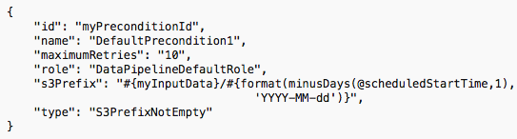
Precondition

Slide 291
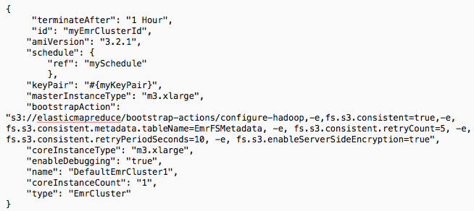
EMR Resource with EMRFS

Slide 292
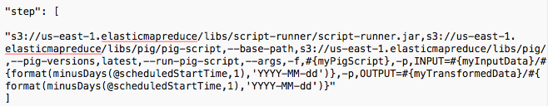
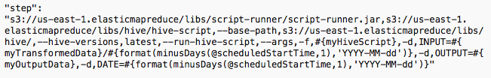
EMR Steps

Slide 293

Schedule

Slide 294
Create and Activate the Pipeline
$ aws datapipeline create-pipeline --name myETLWorkflow --unique-id myETLWorkflow
$ aws datapipeline put-pipeline-definition --pipeline-id df-XXXXXXXXXXX --pipeline-definition file://myWorkflow.json
$ aws datapipeline activate-pipeline --pipeline-id df- XXXXXXXXXXX

Slide 295
Troubleshooting
Locating errors in pipelines
Identify EMR cluster
Pipeline Status
Locating error logs
Common Problems
Notes:
https://aws.amazon.com/blogs/big-data/how-coursera-manages-large-scale-etl-using-aws-data-pipeline-and-dataduct/

Slide 296
Module 12
AWS LAMbda

Slide 297

AWS Lambda: Serverless computing
Run code without servers. Pay only for the compute time you consume.
Triggered by events or called from APIs:
PUT to an Amazon S3 bucket
Updates to Amazon DynamoDB table
Call to an Amazon API Gateway endpoint
Mobile app back-end call
And many more…
Makes it easy to:
Perform real-time data processing
Build scalable back-end services
Glue and choreograph systems

Slide 298
AWS Lambda: Benefits
No servers to manage
Continuous scaling
Subsecond metering

Slide 299
AWS Lambda: Pricing
• Buy compute time in 100 ms increments
• Low request charge
• No hourly, daily, or monthly minimums
• No per-device fees
Never pay for idle!
Free Tier
1 million requests and 400,000 GBs of
compute every month, every customer

Slide 300
AWS Lambda: How it Works?
Invoke function by:
Push model
Pull model
Direct invocation
Author your code in:
Node.js
Java
Python 2.7

Slide 301
AWS Lambda
Push Model
Respond to a specific event
Services
Amazon S3
Amazon SNS
Amazon Cognito
Amazon Echo

Slide 302
AWS Lambda
Poll Model
Polls the event source
Services
Amazon Kinesis
Amazon DynamoDB Streams

Slide 303
AWS Lambda
Direct Invocation Model
Respond to invocation
Services
Custom code
Amazon API Gateway

Slide 304
AWS Lambda: Function
Limits all calls to 300 seconds of runtime
Default timeout of three seconds
Execute function on a regular schedule

Slide 305
AWS Lambda: Restrictions
AWS Lambda blocks inbound network connections
Supports only TCP/IP sockets
Restricts ptrace (debugging) system calls
Restricts TCP port 25 traffic

Slide 306
AWS Lambda: Development and Deployment
Access AWS Lambda from
AWS Management Console
AWS SDKs
AWS CLI
AWS Toolkits for
Eclipse
Visual Studio

Slide 307
AWS Lambda: Creating Our First Lambda Function
Toolbar Set-up

Slide 308
AWS Lambda: Creating Our First Lambda Function
Blueprints
Each blueprint provides sample code and sample configurations to create Lambda functions with just a few clicks.
Filter to search for specific blueprints
For example:
Enter S3 in Filter to get only the list of blueprints available to process Amazon S3 events.
Enter DynamoDB in Filter to get a list of available blueprints to process Amazon DynamoDB events.
Handler
Handler is the function AWS Lambda calls to start execution of your Lambda function.
Identify the handler
AWS Lambda starts executing your code by calling the handler function.
Any event data to this handler as the first parameter.
Process the incoming event data and may invoke any other functions/methods in your code.

Slide 309
AWS Lambda: Creating Our First Lambda Function
Using the Console to build your Lambda functions
Lifecycle of Lambda-based application includes the following:
Author code for Lambda function
Languages supported
Programming model
Package code and dependencies
Tools
Upload code and create a function
Upload code package
Define “Begin Execution”
Specify compute resources like memory and timeout

Slide 310
AWS Lambda: Creating Our First Lambda Function
Using the Console to build your Lambda functions
Lifecycle of Lambda-based application includes the following:
Monitor and Troubleshoot
Metrics available
Troubleshoot in case failures

Slide 311
AWS Lambda: Creating Our First Lambda Function
Create the Function
In the AWS Lambda console, the Code Editor enables you to write, test, and view the execution results of your Lambda function code.
The code editor comprises of the menu bar, windows, and the editor pane.
Menu Bar = Run common commands.
Windows = Work with files, folders, and other commands.
Editor pane = Write code.

Slide 312
AWS Lambda: Creating Our First Lambda Function
Testing and Logging

Slide 313
AWS Lambda: Creating Our First Lambda Function
A Node.js Lambda function

Slide 314
AWS Lambda: Using CLI

Slide 315
AWS Lambda: Using CLI
Managing Push Events And Permissions With The CLI

Slide 316
AWS Lambda: Using CLI
Testing Functions With The CLI

Slide 317
AWS Lambda: Using CLI
Managing Pull Events And Event Source Mappings With The CLI

Slide 318
AWS Lambda: Using CLI
Retrieving Lambda CloudWatch Logs From The CLI

Slide 319
AWS Lambda: Testing Node.js Functions Locally
Creating

Slide 320
AWS Lambda and Amazon API Gateway
Invoking Functions With HTTP Calls Via Amazon API Gateway
Define a custom REST API endpoint
Map individual API operations, such as Get and Put, to specific Lambda functions
Demo

Slide 321
AWS Lambda: Testing Node.js Functions Locally
Creating

Slide 322
AWS Lambda: Daily EBS Snapshots With Scheduled Events
Creating

Slide 323
AWS Lambda: Versions And Aliases With CLI
Creating

Slide 324
Using CloudFormation With Lambda

Slide 325
DynamoDB Table and Lambda Function Creation

Slide 326
Deploying an API With Amazon API Gateway

Slide 327
Module 13
AWS security

Slide 328
Agenda
AWS Shared Responsibility Model
AWS Shared compliance model
Identity and Access Management
Infrastructure Security
DDOS Mitigation
Data Encryption
Inventory and Configurations
Monitoring and Logging
Securing AWS Big Data services like S3, EMR, Kinesis and DynamoDB etc.
Notes:
https://aws.amazon.com/blogs/big-data/how-coursera-manages-large-scale-etl-using-aws-data-pipeline-and-dataduct/

Slide 329
Shared Responsibility Model
Customer Responsibility
AWS Responsibility

Slide 330
Shared Compliance Model
Customer Responsibility
AWS Responsibility

Slide 331

Infrastructure Security
VPC
AWS WAF and Shield
Encryption in transit with TLS across all services
Connectivity options for private and dedicated connections

Slide 332
DDOS Mitigation
Availability is paramount in AWS
AWS Security best practices
Portfolio of services to provide resilience in case of DDOS
AWS Shield and Partner solutions
Services like AutoScaling, Cloudfront, Route 53 etc

Slide 333
Data Encryption
Additional layer of security with data at rest, for example:
Data encryption capabilities in EBS, S3, Glacier, Oracle and SQLServer RDS and Redshift.
Key management with KMS.
SSE with SQS
Dedicated hardware-based cryptographic key storage using AWS CloudHSM
In addition, APIs for you to integrate encryption with any of the services you deploy in an AWS environment.

Slide 334
Inventory and Configuration
Amazon Inspector
Multiple deployment tools to suit organization standards
AWS Config
AWS Cloudformation

Slide 335
Monitoring and Logging
AWS CloudTrail
Log aggregation and streaming investigations
Automation to security events
CloudWatch for alerts for specific events

Slide 336
Identity and Access Management
IAM
MFA
Directory Services

Slide 337
EMR Security
VPC Public Subnet/Private Subnet
S3 Endpoint
Use IAM for Users and IAM Roles for Service Role
SSL endpoints for EMR Consoles like ResourceManager, Hue etc
EMR Default Security Groups architecture
ElasticMapReduce-master
ElasticMapReduce-slave
Granular control using tags
Data Encryption

Slide 338

Data Encryption Options in EMR

Slide 339

Security: S3

Slide 340
Security: Kinesis
Control using IAM
Interface VPC Endpoint
Server Side encryption

Slide 341
Lab: Securing EMR with Encryption

Slide 342
Module 14
Managing costs

Slide 343
Managing Costs
EMR Pricing
Transient vs Long running cluster
Auto-Scaling with EMR
Ec2 pricing models
Spot Fleet
Spot strategies for EMR cluster

Slide 344
Managing Costs
When use Spot?
Alphasense Use Case
S3 Pricing
Data Transfer Costs
Kinesis pricing
DynamoDB pricing

Slide 345
Module 15
Devops basics

Slide 346

DevOps?

Slide 347
Benefits of DevOps
Speed
Rapid Delivery
Reliability
Scale
Improved collaboration
Security (DevSecOps)

Slide 348
Important DevOps Practices
Infrastructure as code
Continuous integration
Continuous Delivery
Communication and Collaboration

Slide 349
Infrastructure as Code
Introducing AWS Cloudformation
An easy way to create and manage a collection of related AWS resources, provisioning and updating them in an orderly and predictable fashion. You can use AWS CloudFormation’s sample templates or create your own templates.

Slide 350
Demo/Lab: CloudFormation

Slide 351


Slide 352

Continuous Integration
Benefits:
Improved developer productivity
Find and address bugs quickly
Deliver updates faster

Slide 353

AWS Code Pipeline
AWS CodePipeline is a continuous integration and continuous delivery service for fast and reliable application and infrastructure updates.
CodePipeline builds, tests, and deploys your code every time there is a code change, based on the release process models you define.

Slide 354
Demo/Lab: Code Pipeline

Slide 355
AWS CodeBuild
Fully managed build service that compiles source code, runs tests, and produces software packages that are ready to deploy.
With CodeBuild, you don’t need to provision, manage, and scale your own build servers.

Slide 356
AWS CodeDeploy
Automates software deployments to a variety of compute services including Amazon EC2, AWS Lambda, and instances running on-premises.
Rapidly release new features
Handles the complexity of updating your applications.
Automate software deployments, eliminating the need for error-prone manual operations.
Scalable, from a single Lambda function to thousands of EC2 instances.

Slide 357
CodeDeploy: Benefits
Automated Deployments
Minimize Downtime
Centralized Control
Easy To Adopt

Slide 358
AWS CodeStar
Enables you to quickly develop, build, and deploy applications on AWS.
Provides a unified user interface, easily manage your software development activities
Set up your entire continuous delivery toolchain in minutes
Start releasing code faster

